Slide 1
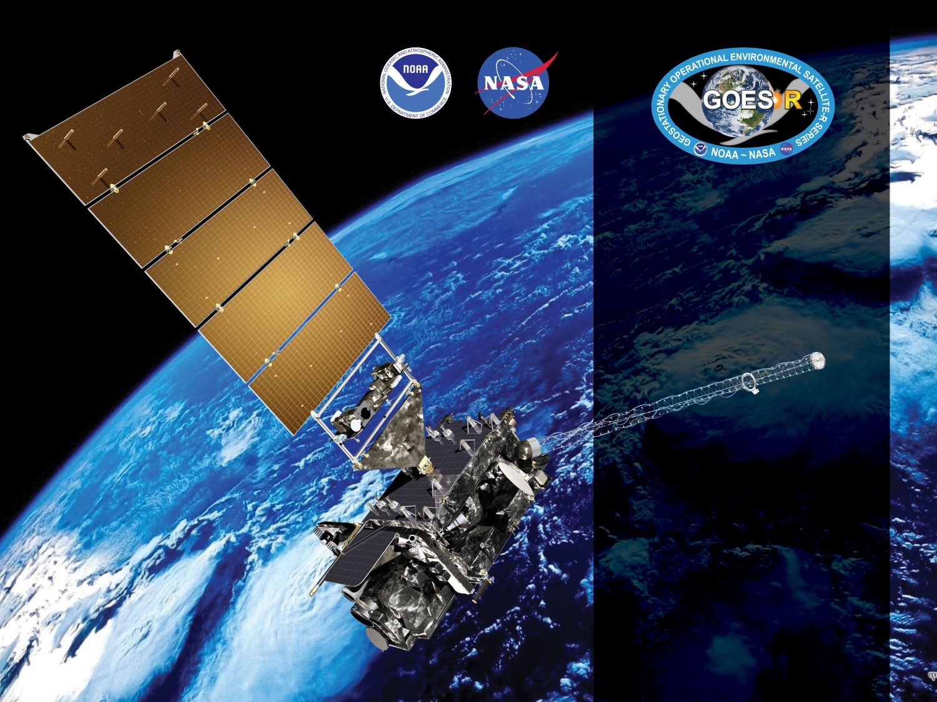
GOES-17 ABI L2+ Aerosol Optical Depth Provisional PS-PVR
Status and Plan for Assessing Warm Periods
June 27, 2019
GOES-R AWG
Istvan Laszlo¹, Mi Zhou², Hongqing Liu² and the
PRO Team
¹NOAA/NESDIS/STAR
²I.M. Systems Group, Inc.

Slide 2
Outline
Product Overview
Review of ADRs
Provisional Maturity Assessment
  Comparisons with AERONET, VIIRS, MODIS and GOES-16
Plan for Assessing Warm Periods
  GOES-17 LHP Anomaly Impact and Mitigation
Path to Full Validation Maturity
Summary and Recommendations
Supplement
  Impact of LWIR FPM Anomaly (79-85)
  Impact of ABI Band 2 gain change (86-93)
  Brief overview of the AOD algorithm (94-96)

Slide 3
Product Overview
  Aerosol optical depth (AOD):
    A measure of the columnar extinction (scattering + absorption) of radiation by aerosols. Proportional to the amount (number or mass concentration) of aerosol in an atmospheric column.
  Products in file (post Beta):
    550-nm AOD for Full Disk and CONUS in range -0.05 to +5
    Quality flag (0=high; 1=medium, 2=low, 3=not produced)
    Mean, max, min and standard deviation of 550-nm AOD (and in 10-degree latitude zones)

Slide 4
Product Overview
Product Definition and user’s guide (Pug) Volume 5: Level 2+ Products, REVISION D.2, 24 MARCH 2016 - Table 5.10.1
 |  | Measurement |  |  |  | Mapping
Region | Surface Type | Range | Accuracy | Precision | Performance Conditions ^{[1]} | Accuracy
Full Disk & CONUS | Over Land | -0.05 to 5 | (1) AOD < 0.04: 0.06 (2) 0.04 ≤ AOD ≤ 0.80: 0.04 (3) AOD > 0.80: 0.12 | (1) AOD < 0.04: 0.13 (2) 0.04 ≤ AOD ≤ 0.80: 0.25 (3) AOD > 0.80: 0.35 | LZA ≤ 60 degrees daytime ^{[2]} clear sky | 1 km
Full Disk & CONUS | Over Ocean | -0.05 to 5 | (1) AOD < 0.40: 0.02 (2) AOD > 0.40: 0.10 | (1) AOD < 0.40: 0.15 (2) AOD > 0.40: 0.23 | LZA ≤ 60 degrees daytime ^{[2]} clear sky | 1 km
[1] Conditions for data production prescribed by the algorithm also include snow/ice-free and, when over ocean, sunglint angle > 40 degrees.
[2] Conditions for high quality prescribed by the algorithm are for SZA ≤ 80 degrees.
Horizontal resolution: 2 km
Temporal resolution: 5 min (CONUS), 15/10 min (M3/M6 Full Disk) – mode dependent

Slide 5
GOES-R AOD Product
Precedence Chain
4-level Cloud Mask
Cloud & Moisture Imagery
Snow Mask
ABI FSC product
IMS/SSMI snow ice mask
AOD
TPW
ABI product
GFS product
Climatology

Slide 6
Pre-Provisional Time-Line
01 Mar 2018 GOES-S Launch
27 Aug 2018 GOES-17 AOD Beta Maturity
24 Oct –13 Nov 2018 Spacecraft Drift to West Slot
14 Nov 2018 Begin data collection and analysis for Provisional PS-PVR
12 Feb GOES-17 declared GOES-West
02 Apr 2019 Switch from M3 to M6
15 Apr 2019 PR.07.10.00 fixed zonal averages in metadata
27 Apr 2019 B02 gain value correction
06 May 2019 Clear-Sky Mask reached Provisional maturity for cool period
27 Jun 2019 GOES-17 AOD PS-PVR Provisional

Slide 7
ADRs IN PROGRESS PRIOR TO GOES-17 AOD PROVISIONAL REVIEW
GOES-17 Aerosol Optical Depth L2 Product Provisional PS-PVR

Slide 8
ADRs Installed or in Progress
Title | Description | Impact | Mitigation | Status
ADR 758 | Mismatched zonal averages and ‘latitude_band_bounds’ | Leads to incorrect interpretation of zonal averages. | PR.07.10.00 | Installed
ADR 920 | Incorrect latitude band percentage metadata | Leads to incorrect interpretation of zonal percentage metadata. | To be fixed when Enterprise Algorithm delivered | On hold
ADR 801 | Flag to indicate source of TPW is incorrectly set | Cannot identify source (ABI or model) of TPW used in AOD retrieval; hinders deep-dive analysis. | -”- | On hold
ADR 899 | Optimize TPW usage | Find a solution to allow AOD use current Sounding TPW, either through reducing the time delay for TPW or through a new executive allowing for a timeout of a 'critical' input before going to the backup input." | Needs L2 Infrastructure work | On hold
ADR 818 | Inconsistency in spatial coverage between M3 (M6) and M4 | Smaller spatial coverage from M4 than from M3. | Solution is known | In analysis
ADR 947 | Occasional missing data blocks | Decreased spatial coverage; may miss events. | -”- | In analysis
Applies to both G16 and G17.
No “Big Impact” items.
None of these affects product quality in terms of accuracy and precision, except maybe ADR899.
Little Impact
Moderate Impact
Big Impact

Slide 9
Product quality evaluation
GOES-17 Aerosol Optical Depth L2 Product Provisional PS-PVR

Slide 10
Provisional PLPTs
PLPT ID | Descriptive Title | % Complete | Results | POC
ABI-FD_AOD07 | Assess precision and accuracy of FD product for an extended period that includes some but not all seasonal variability, to facilitate a user decision on operational readiness. | 100 | Complete | AWG
ABI-CONUS_AOD08 | Assess precision and accuracy of CONUS product for an extended period that includes some but not all seasonal variability, to facilitate a user decision on operational readiness | 100 | Complete | AWG
AWG AOD Team conducted these tests to evaluate the L2 AOD product quality.
Full test plans and procedures are given in the AOD Readiness, Implementation, and Management Plan (RIMP v1.0; 416-R-RIMP-0326).

Slide 11
Application of PLPT Qualitative & Quantitative Analysis Tests to each Domain
The analysis has 6 elements.
Each element is applied on the FD and CONUS domains.
Analysis Method |  | FD | CONUS
Visual | Visual Inspection of GOES 17 AOD
 | Visual Comparison with VIIRS AOD
Quantitative | Comparison with ground measurements (AERONET)
 | Comparison with VIIRS AOD product
 | Comparison with MODIS AOD product
 | Comparison with GOES 16 AOD product

Slide 12
GOES-17 Data Used in this Review
Time period: 01/01/2019 – 05/31/2019
  All daytime retrievals are used except the ones impacted by the LWIR FPM anomaly. Times of excluded observations are determined from the table below.
Matchups:
  G17 FD and CONUS AOD and AERONET AOD;
  G17 FD and CONUS AOD and VIIRS/MODIS/G16 AOD.
2019 ABI CHANNEL SATURATION PREDICTIONS
1 Jan – 26 Feb | Channel saturation begins starting with bands in this order: 10, 12, 16, 8, 9, 15, 11 from marginal to unusable by the end of the time period. Peak saturation for all bands is estimated to occur on 26 February. | Saturation can occur daily between 0830-1730 UTC with peak saturation occurring at approximately 1300 UTC.
26 Feb – 20 Mar | Channel saturation improves starting with bands in this order: 11, 15, 9, 10, 12, 8, 16 from unusable to marginal by the end of the time period. | Saturation can occur daily between 0900-1700 UTC with peak saturation occurring at approximately 1300 UTC.
20 Mar – 13 Apr | Channel saturation begins starting with bands in this order: 10, 12, 16, 8, 9, 15, 11, 13 from marginal to unusable by the end of the time period. Peak saturation for all bands is estimated to occur on 13 April. | Saturation can occur daily between 0900-1700 UTC with peak saturation occurring at approximately 1300 UTC.
13 Apr – 26 May | Channel saturation improves starting with bands in this order: 13, 11, 15, 9, 10, 12, 8, 16 from unusable to marginal by the end of the time period. | Saturation can occur daily between 0900-1700 UTC with peak saturation occurring at approximately 1300 UTC.
26 May – 20 Jul | No channel saturation

Slide 13
Examples of Visual Inspection
GOES-17 Aerosol Optical Depth L2 Product Provisional PS-PVR

Slide 14
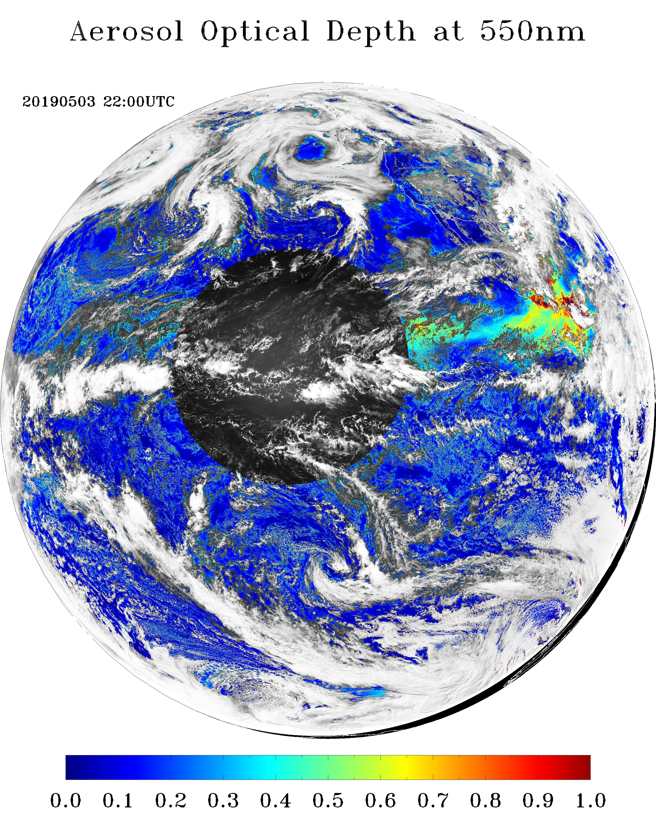
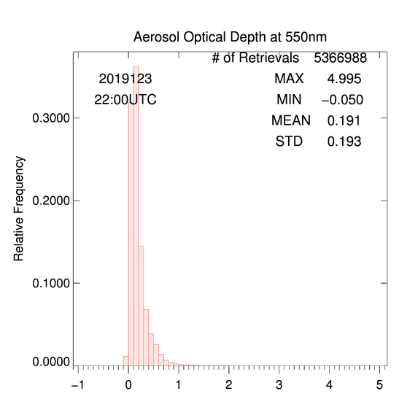
GOES-17 AOD Image – Full Disk
Low + Medium + High Quality AOD
05/03/2019
AOD field “looks” reasonable, values are within expected range.

Slide 15
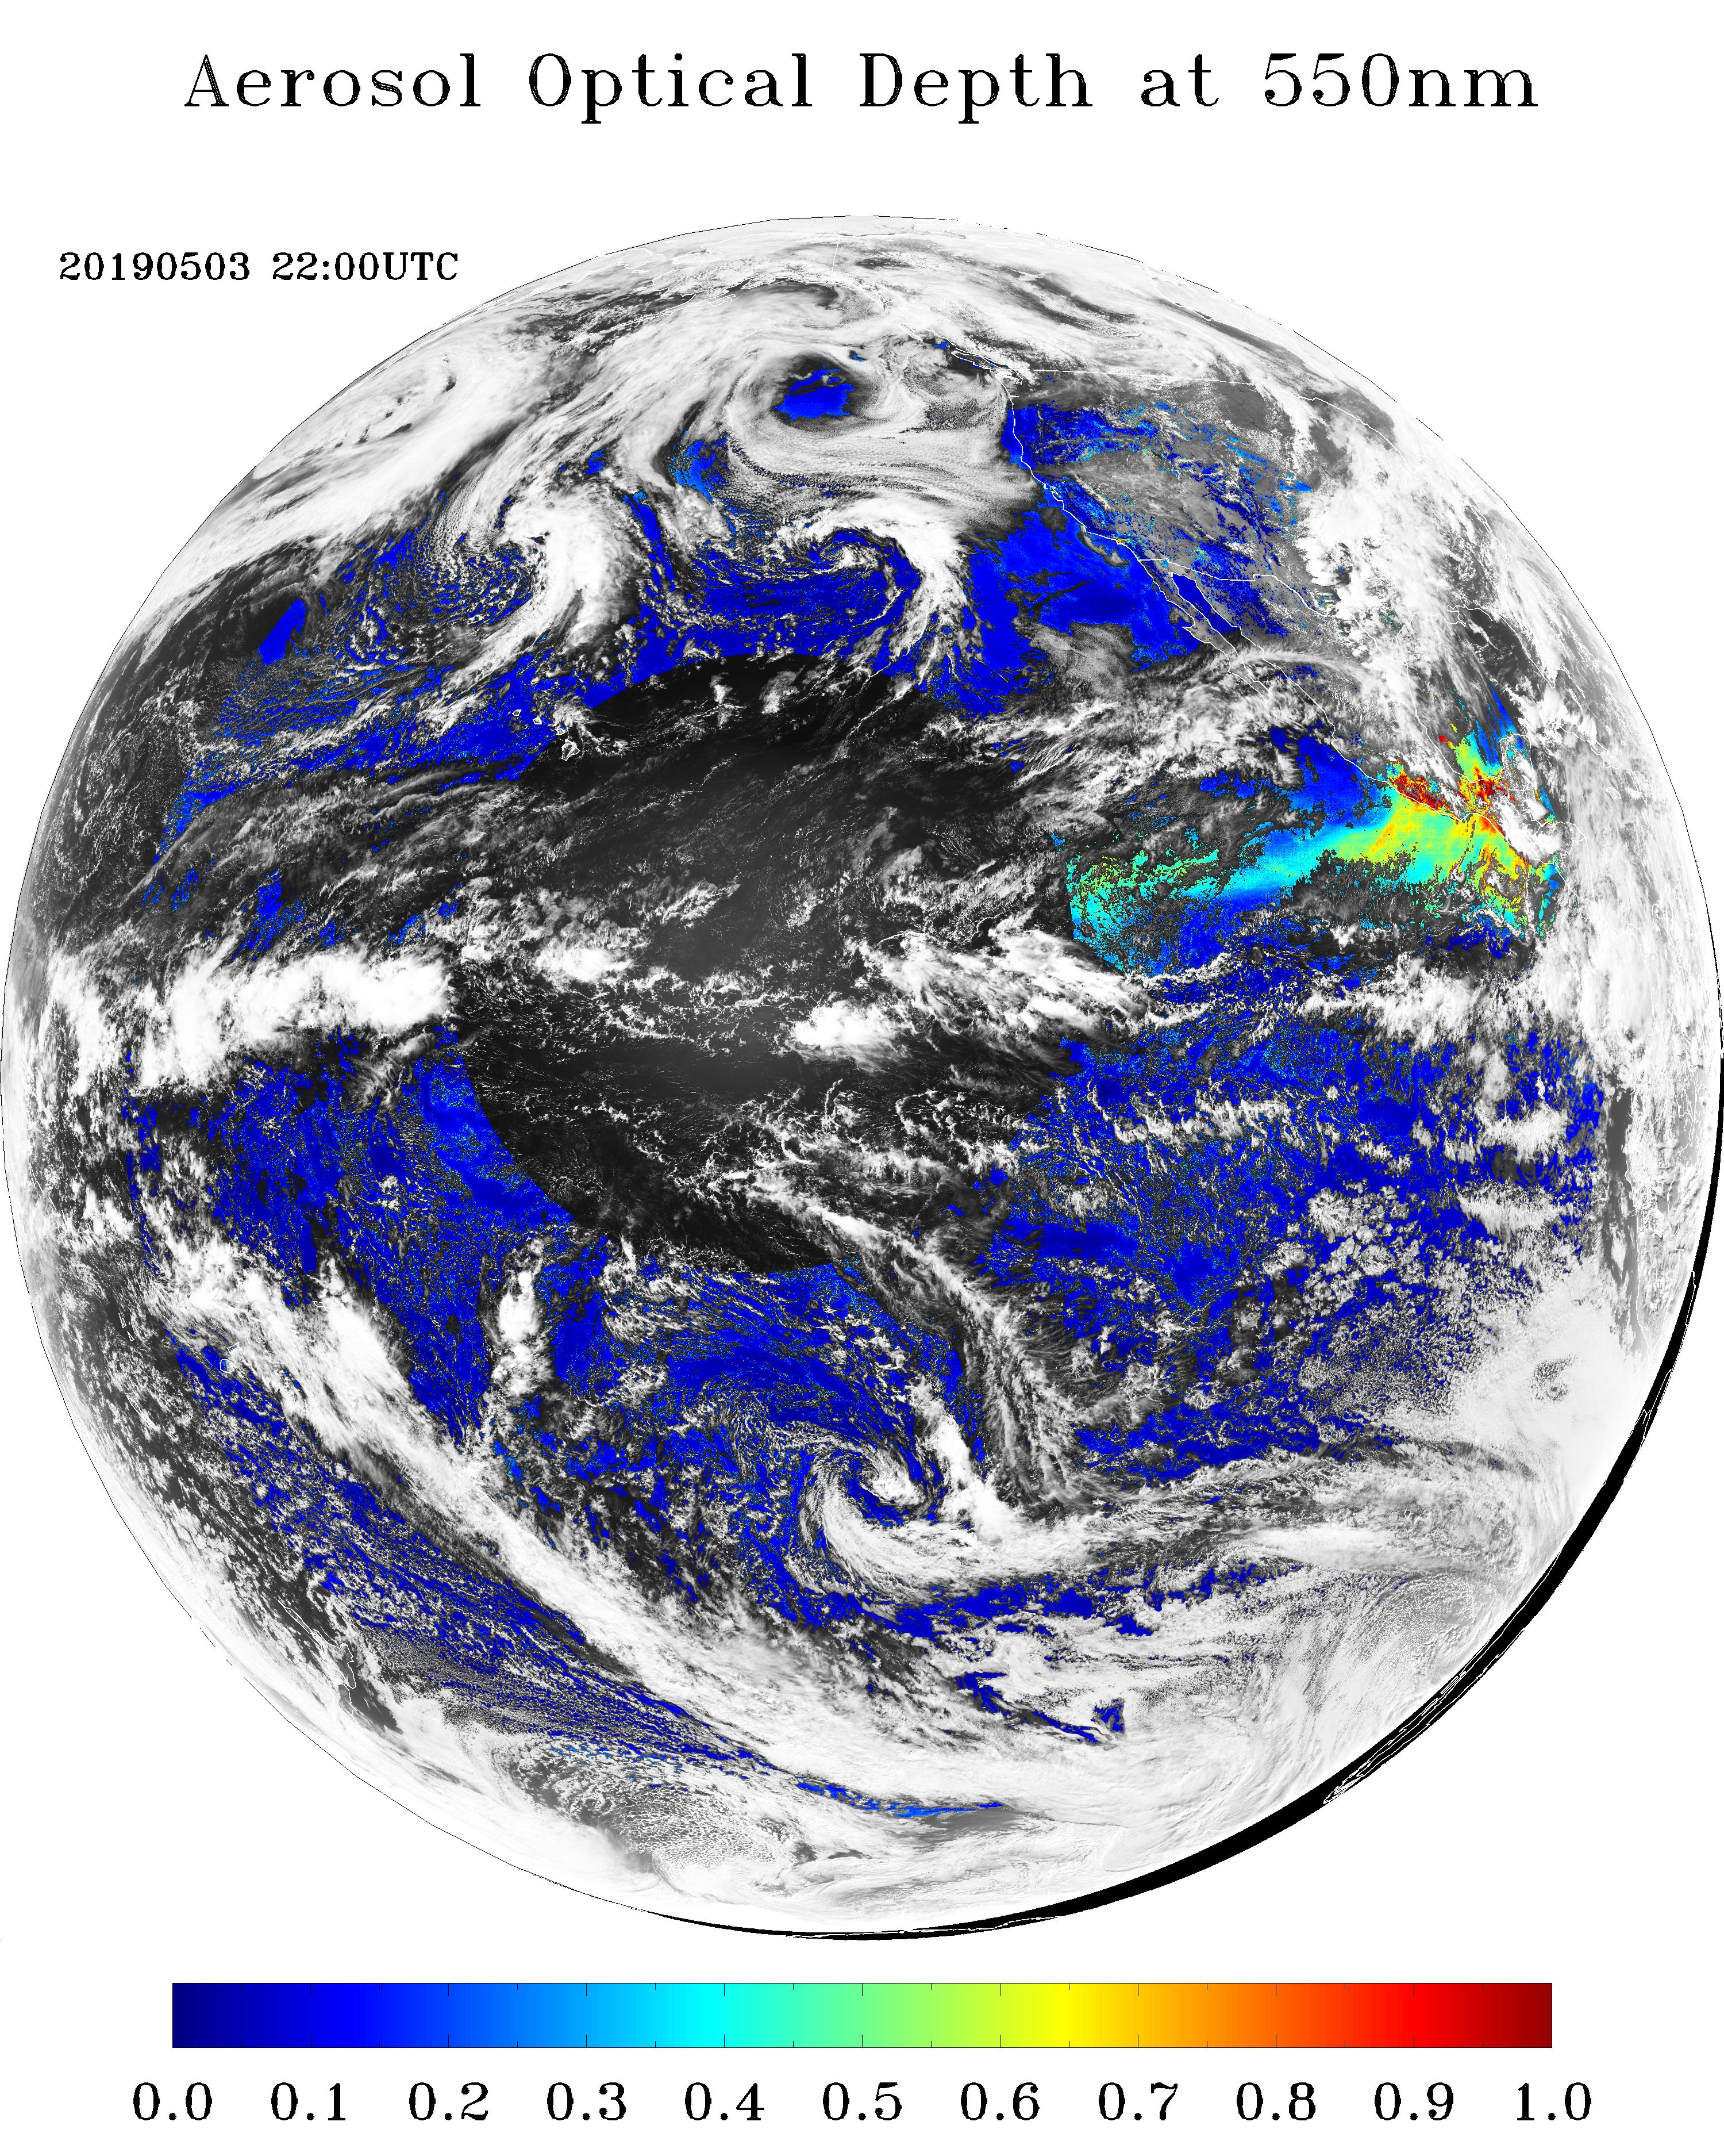
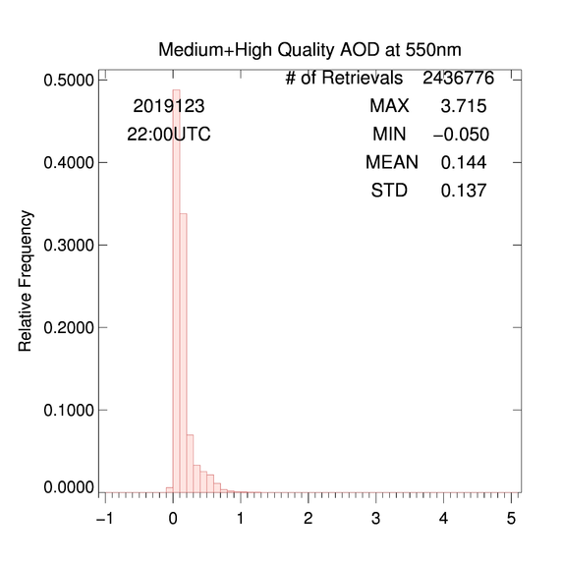
GOES-17 AOD Image – Full Disk
Medium + High Quality AOD
05/03/2019
Filtering out low-quality data decreases availability of AOD as expected and lowers max AOD.

Slide 16

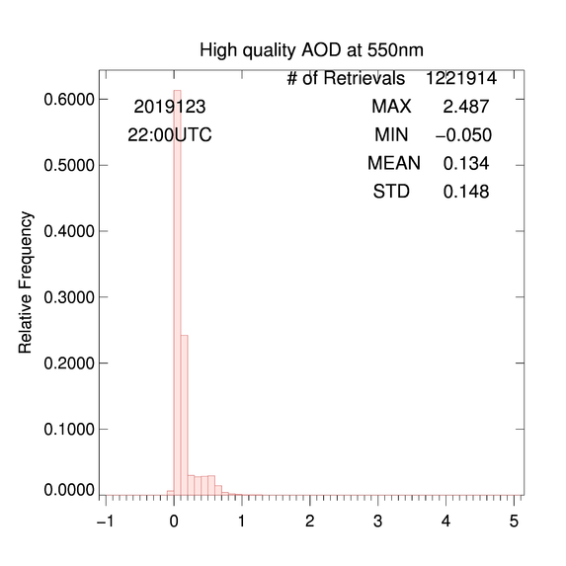
GOES-17 AOD Image – Full Disk
High Quality AOD
05/03/2019
Additional filtering for medium-quality data further decreases availability of AOD and lowers max AOD.

Slide 17
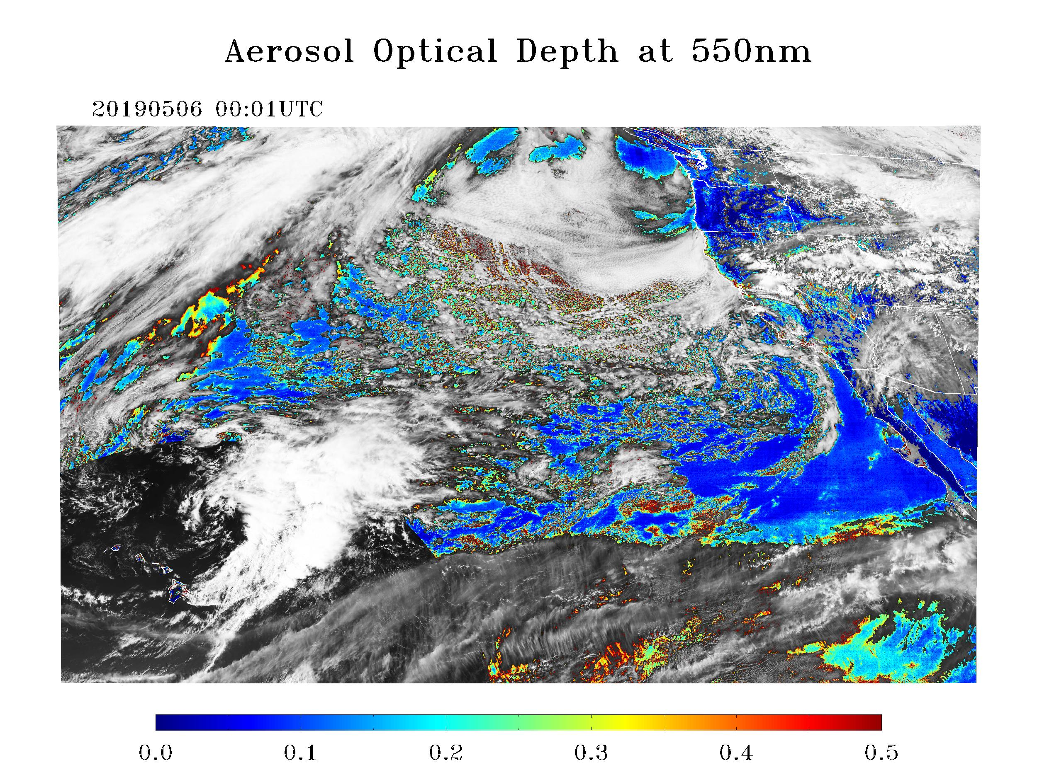
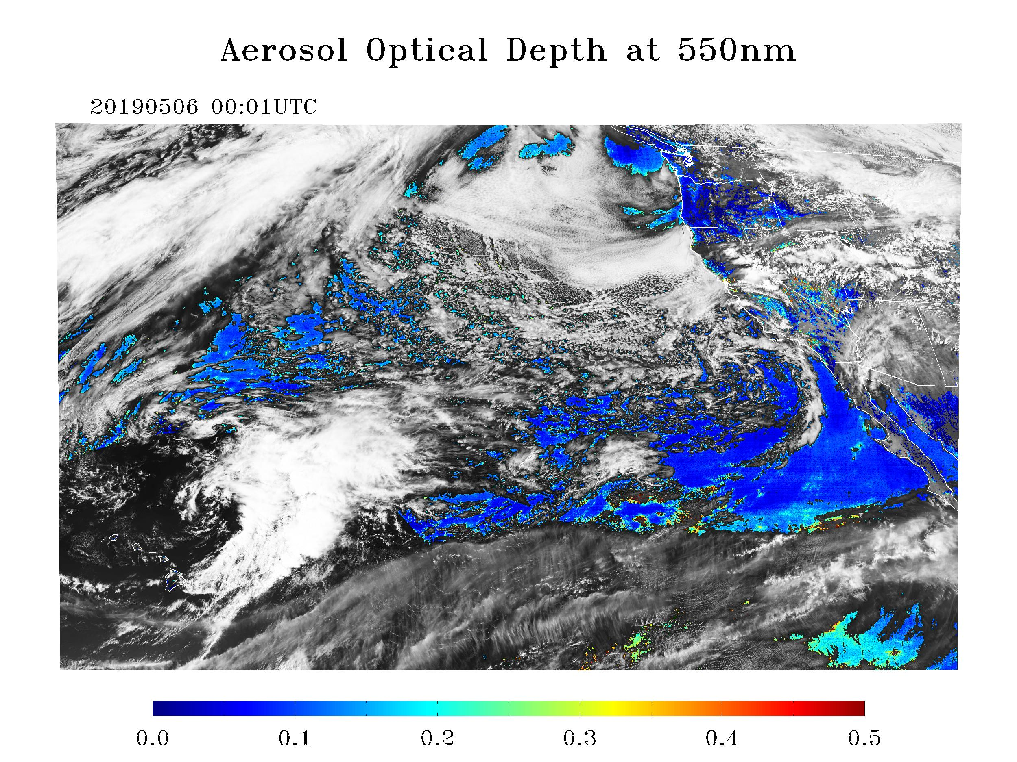
GOES-17 AOD Image – CONUS
05/06/2019
Low + Medium + High QC
Medium + High QC
AOD field “looks” reasonable.
Filtering out low-quality data decreases availability of AOD as expected .

Slide 18
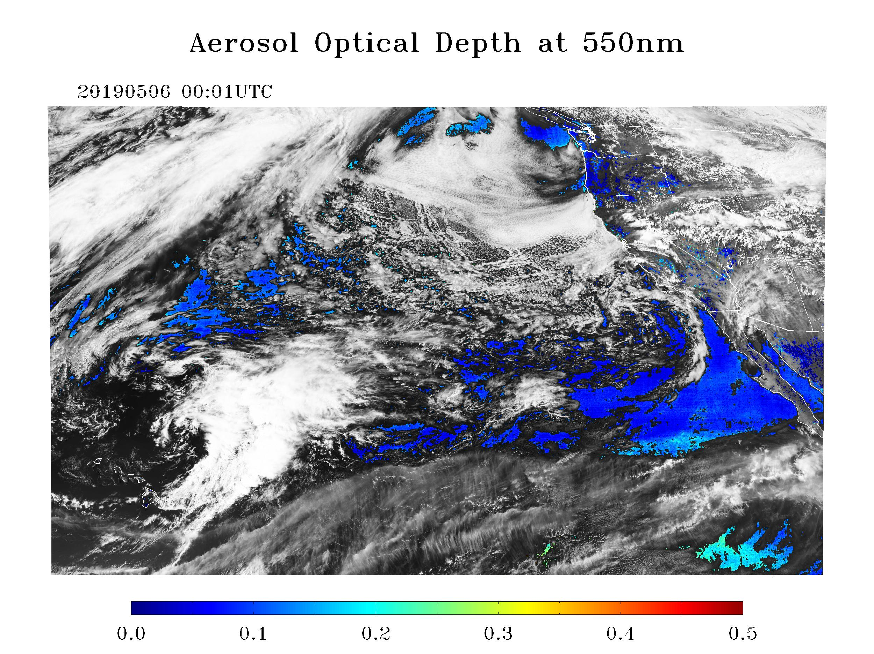
GOES-17 AOD Image – CONUS
05/06/2019
Medium + High QC
High QC
Filtering out low- and medium-quality data further decreases availability of AOD as expected .

Slide 19
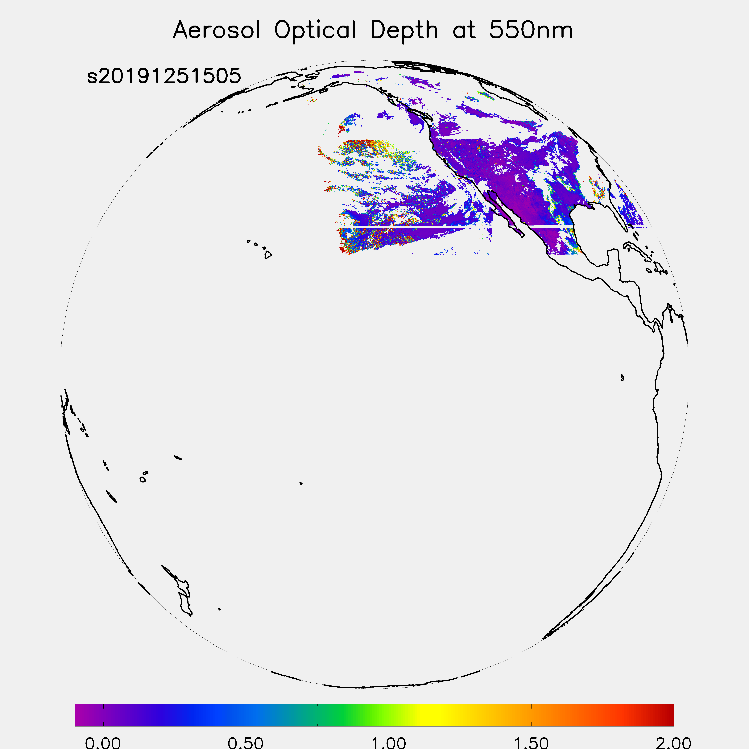
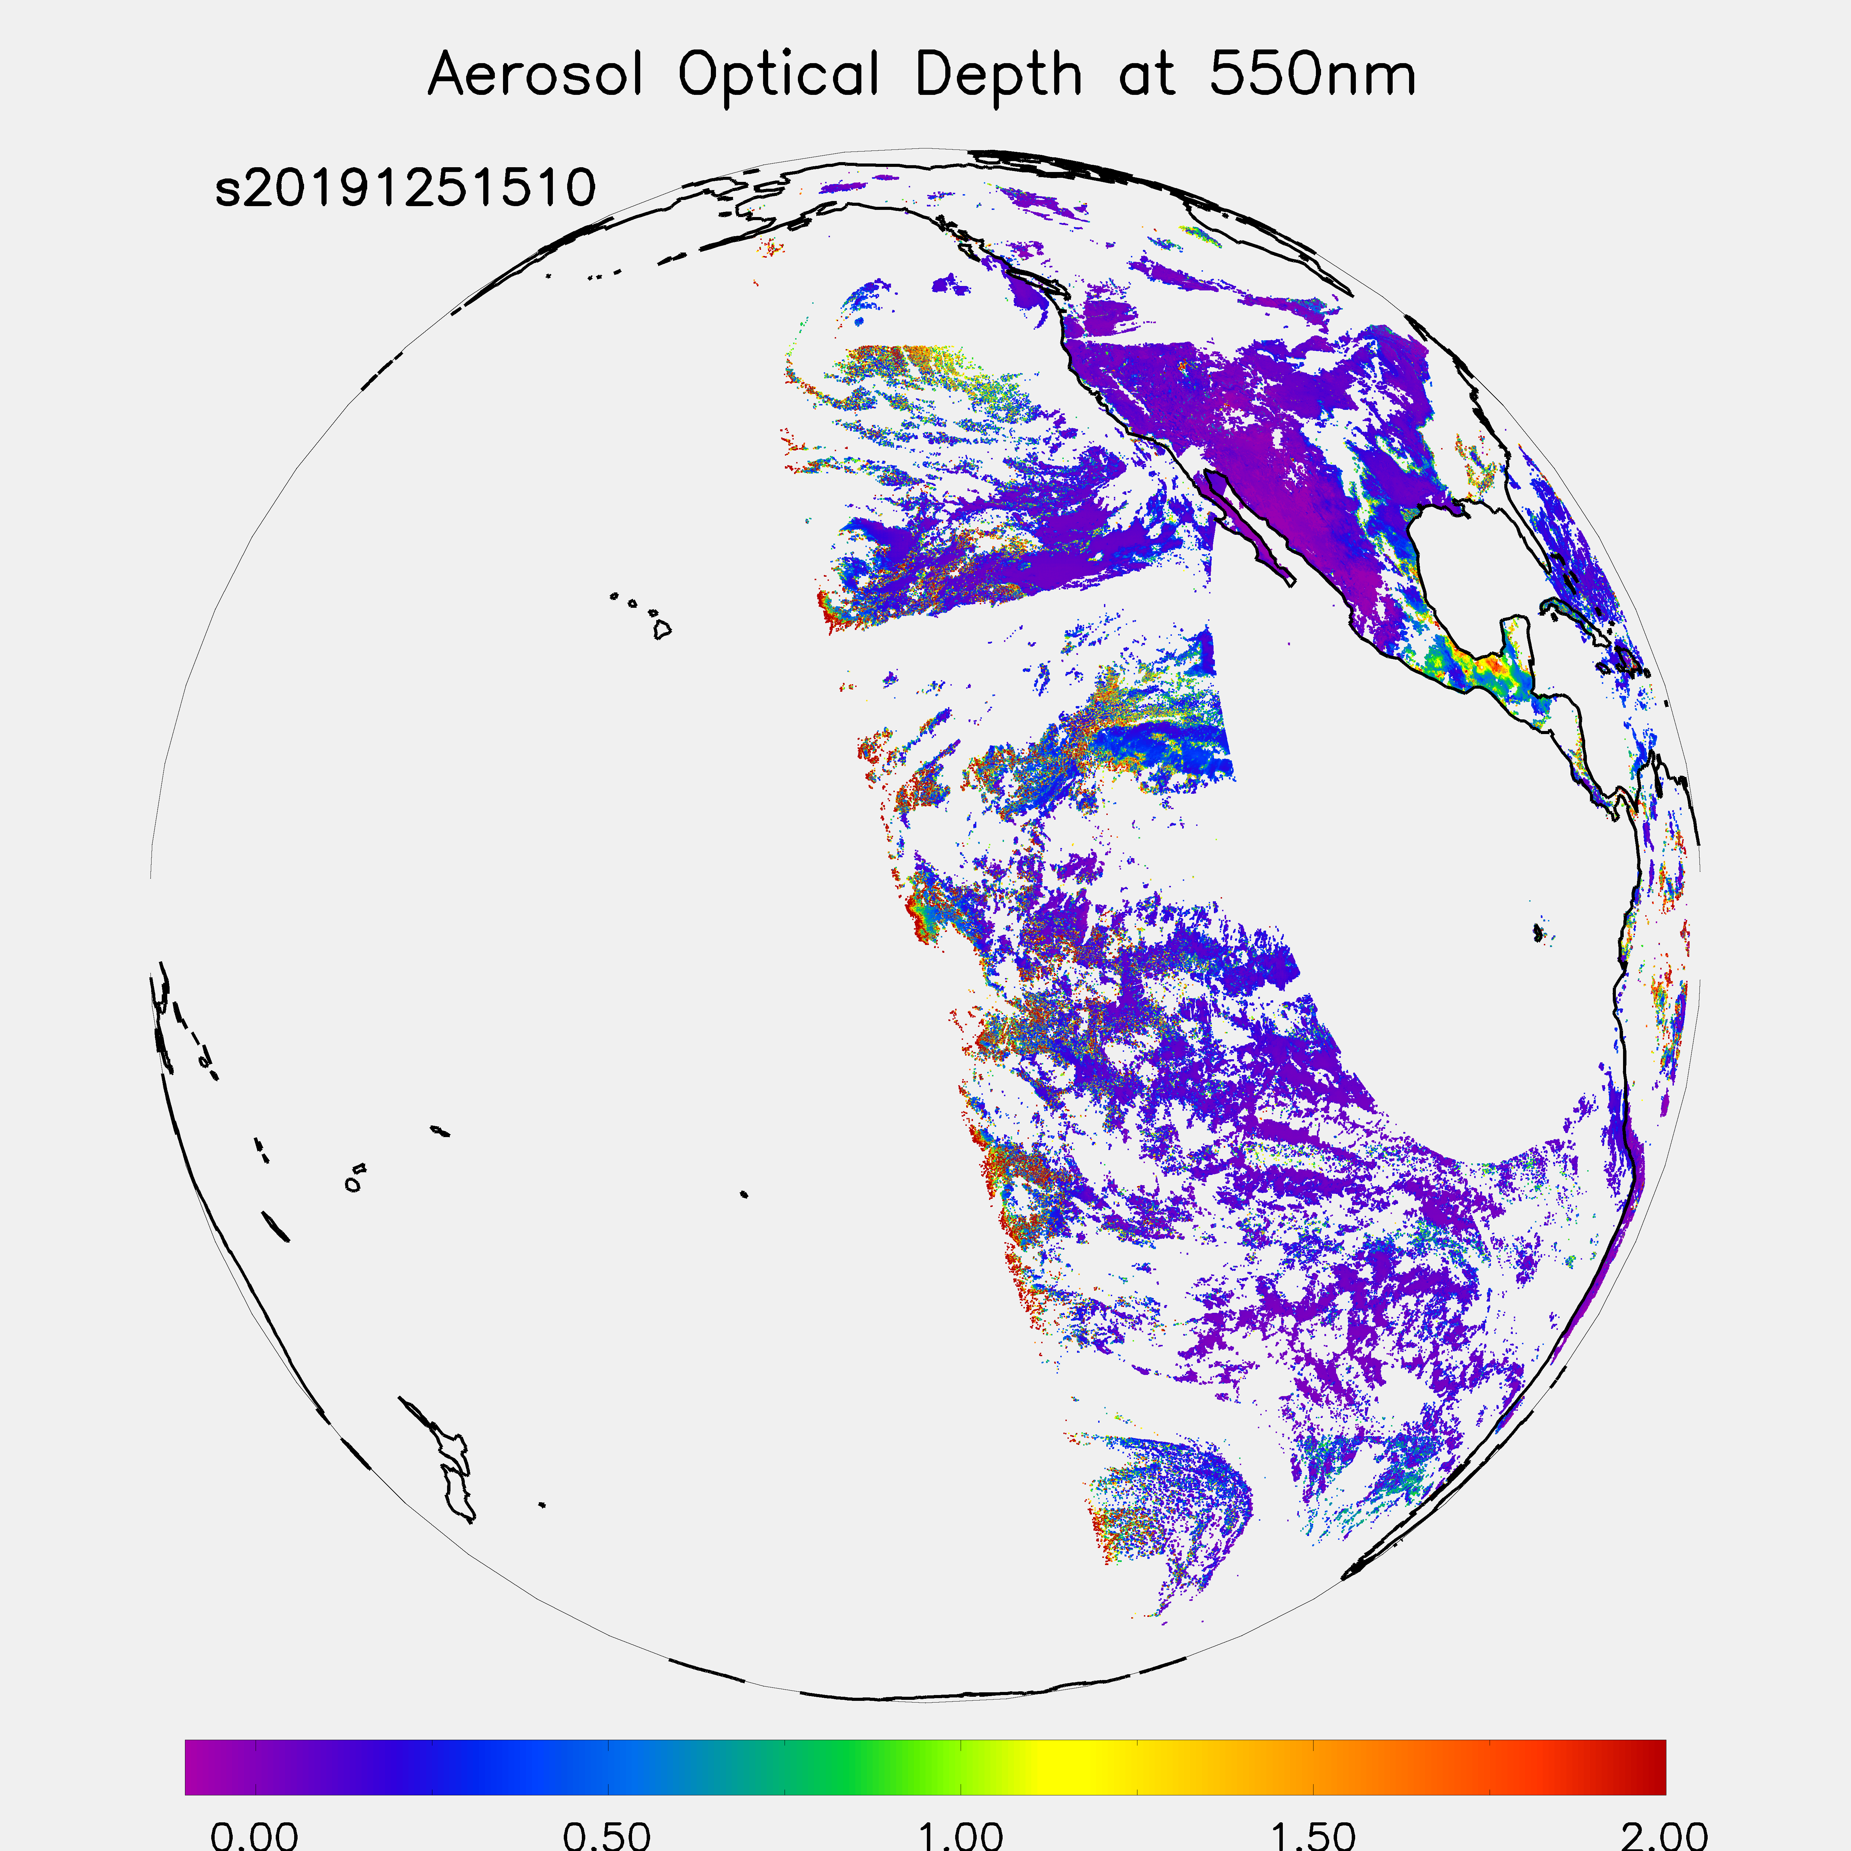
AOD M4 vs. M6 Difference in Spatial Coverage
May 5, 2019
M4
15:05 UTC
M6
15:10 UTC
Side by side comparison of M4 vs. M6 all-quality AOD spatial coverage.
M4 has more missing data blocks.

Slide 20
VISUAL Comparison with VIIRS AOD
GOES-17 Aerosol Optical Depth L2 Product Provisional PS-PVR

Slide 21
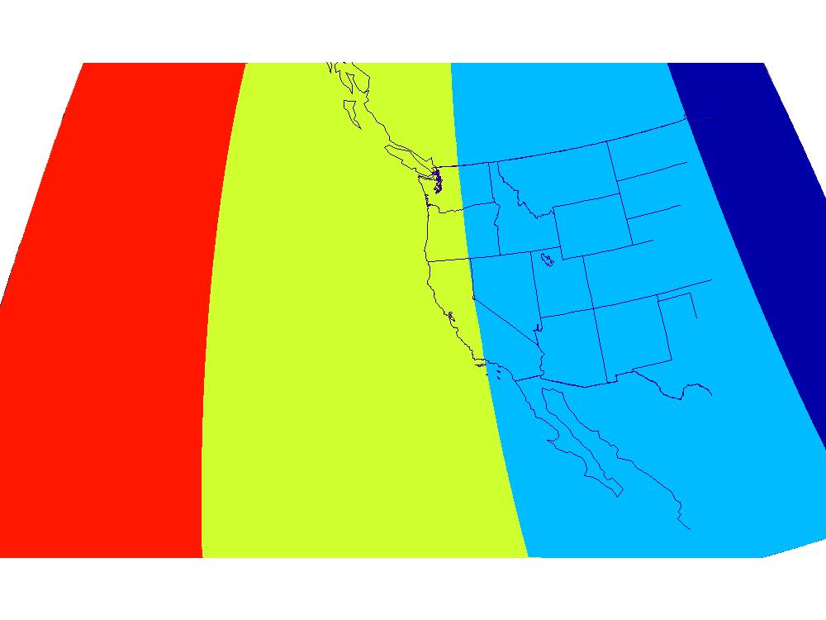
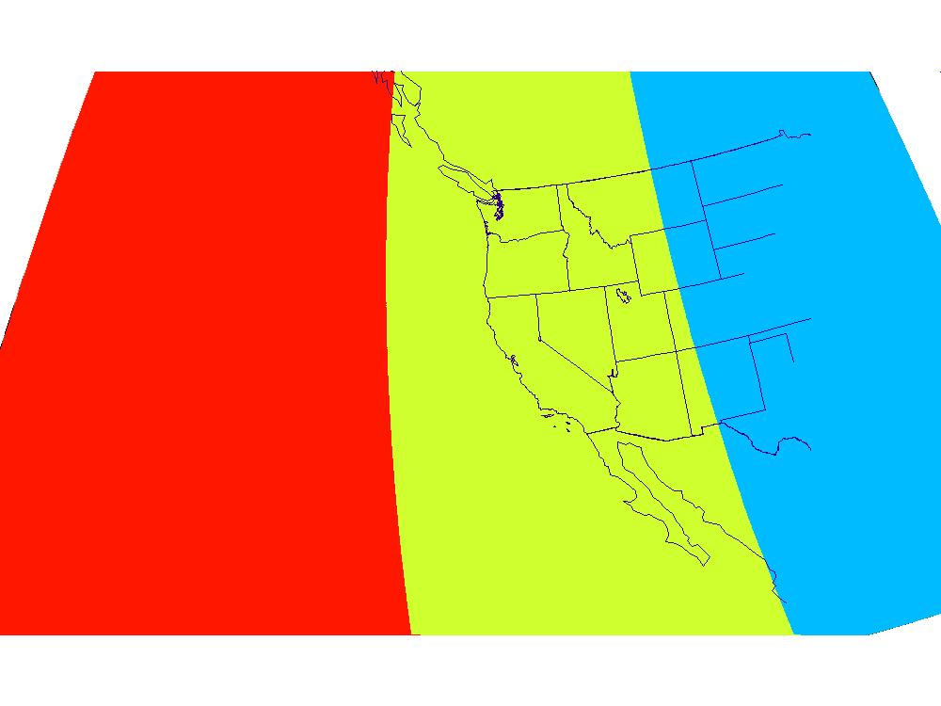
Matching GOES-17 AOD with VIIRS AOD
S-NPP
05/01/2019
Mask
NOAA20
23:50
22:10
20:30
18:50
23:00
21:20
19:40
S-NPP and NOAA-20 AODs are matched with GOES-17 Baseline AOD.
VIIRS swaths are used as masks to ABI AOD.

Slide 22
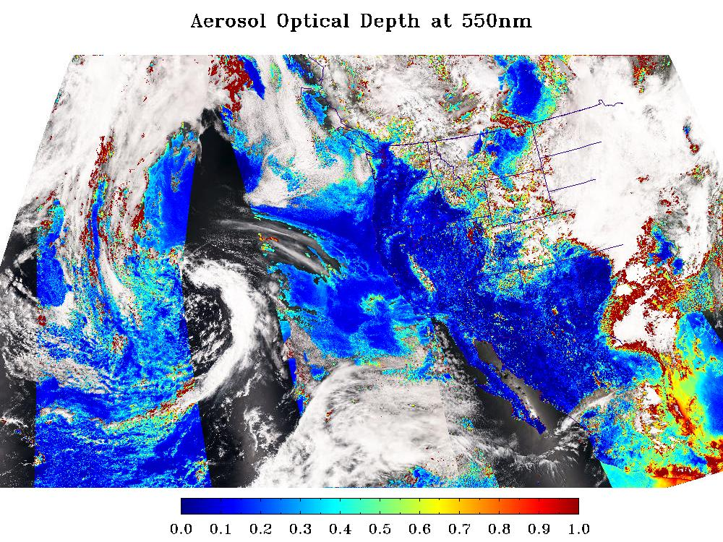
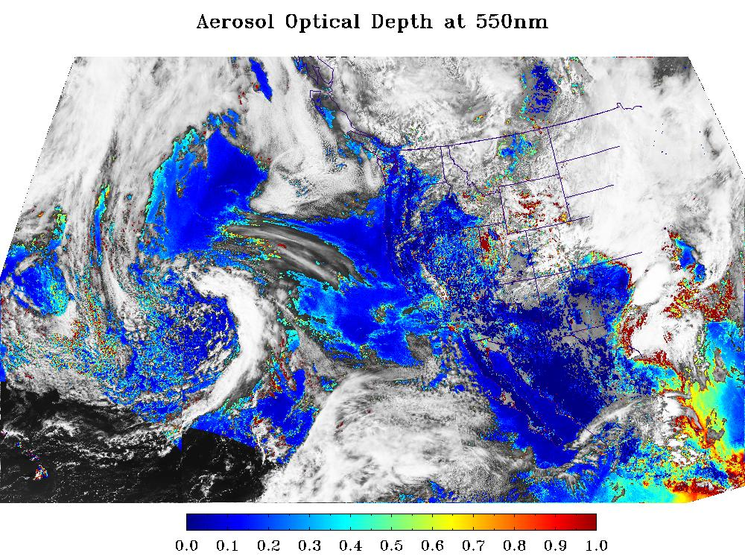
S-NPP vs. GOES-17
Low+Medium+High QC AOD
S-NPP/VIIRS
05/01/2019
GOES-17/ABI
23:50
22:10
20:30
18:50
23:50
22:10
20:30
18:50
At some places ABI AOD is higher/lower than VIIRS AOD, but …
Overall ABI and VIIRS low+medium+high QC AOD fields are visually similar enough.
Fewer ABI retrievals (2-km ABI vs. 0.75-km VIIRS, and no ABI retrieval over bright land).

Slide 23
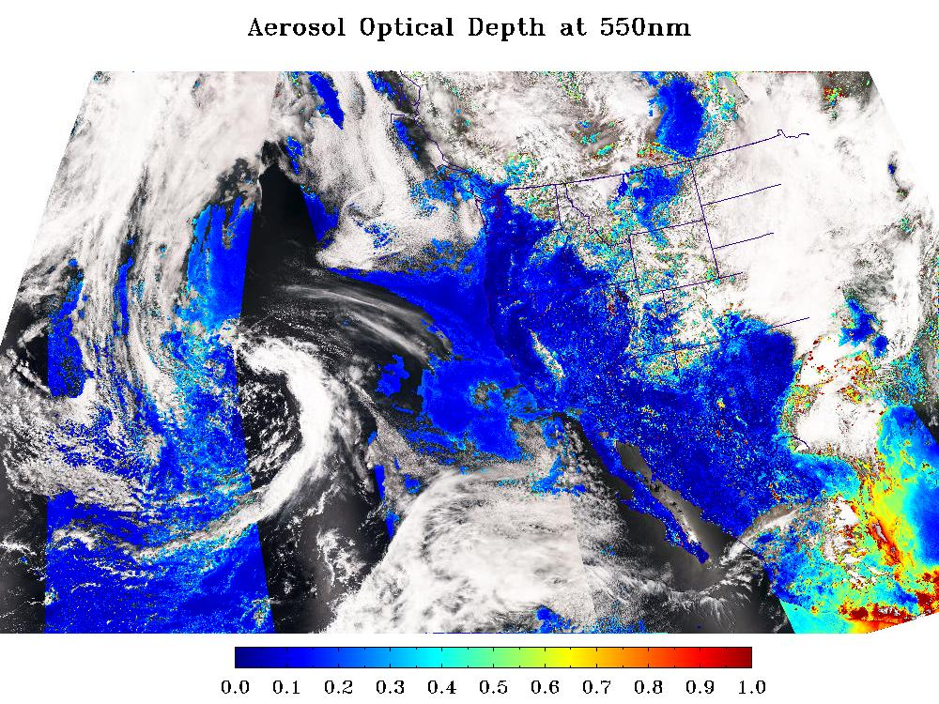
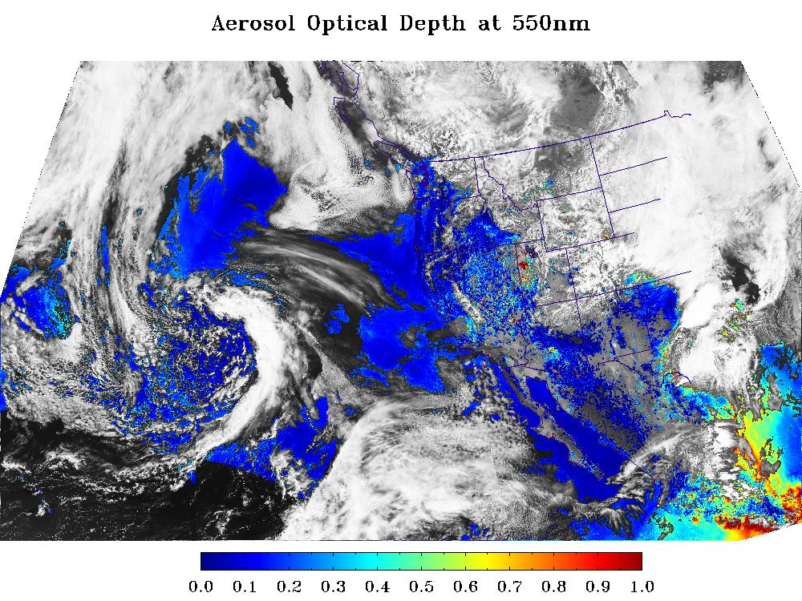
S-NPP vs. GOES-17
Medium+High QC AOD
S-NPP/VIIRS
05/01/2019
GOES-17/ABI
23:50
22:10
20:30
18:50
23:50
22:10
20:30
18:50
ABI satellite zenith angle threshold of 60º excludes retrievals over North East.
Spatial variability test of 3x3 pixels excludes pixels with high spatial variability. More ABI pixels are excluded due to larger pixel size (2-km ABI vs. 0.75-km VIIRS).
Notes:
More G17 AOD < -0.05 retrievals over land (likely due to using G16, not G17, land surface relationship). These are degraded as low quality and thus do not appear in this plot.

Slide 24

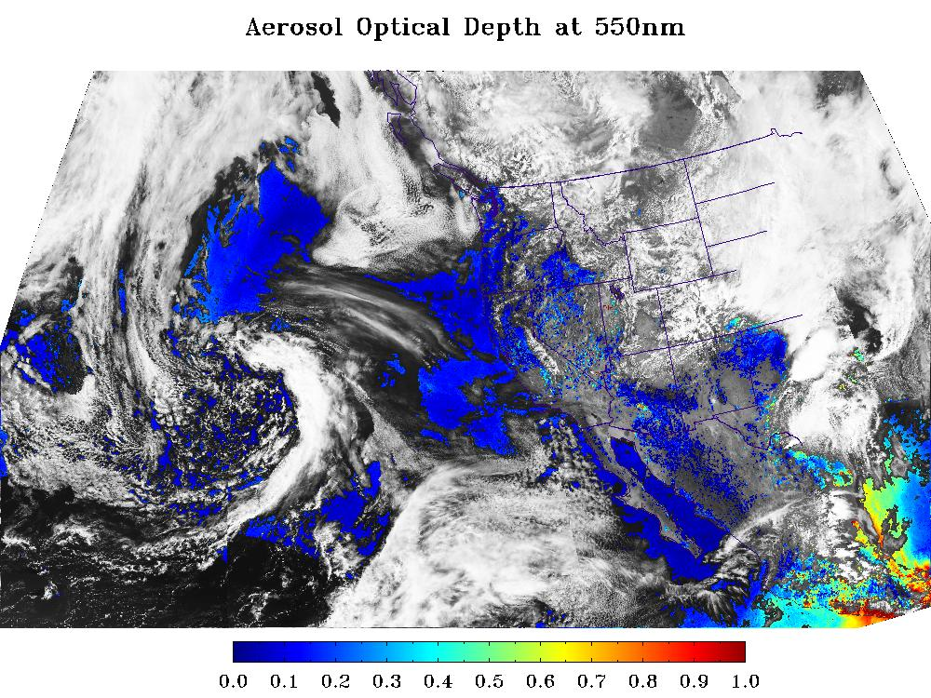
S-NPP vs. GOES-17
High QC AOD
S-NPP/VIIRS
05/01/2019
GOES-17/ABI
23:50
22:10
20:30
18:50
23:50
22:10
20:30
18:50
Additional internal tests and more stringent criteria for spatial variability excludes more pixels in both ABI and VIIRS AOD fields.

Slide 25
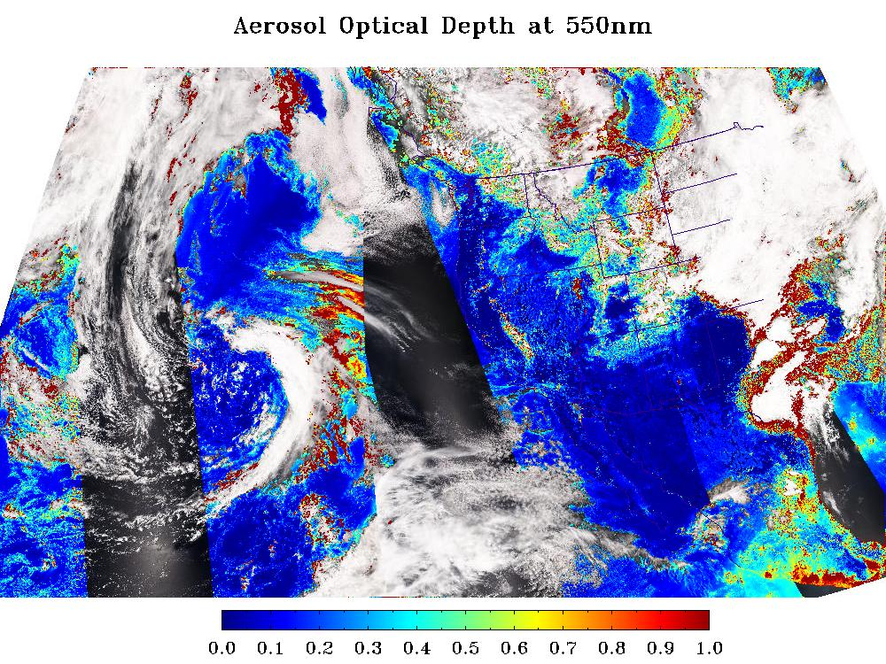
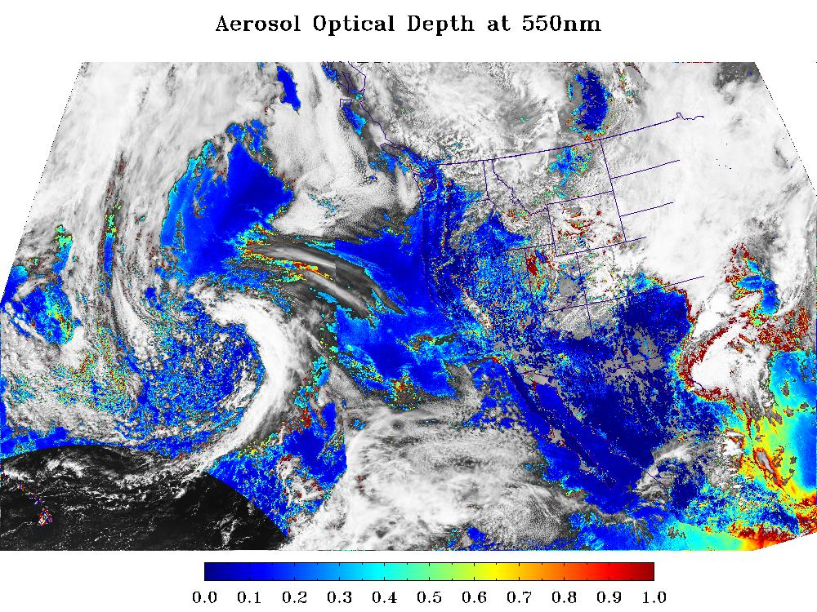
NOAA-20 vs. GOES-17
Low+Medium+High QC AOD
NOAA-20/VIIRS
05/01/2019
GOES-17/ABI
23:00
21:20
19:40
23:00
21:20
19:40
Same findings as for S-NPP.

Slide 26
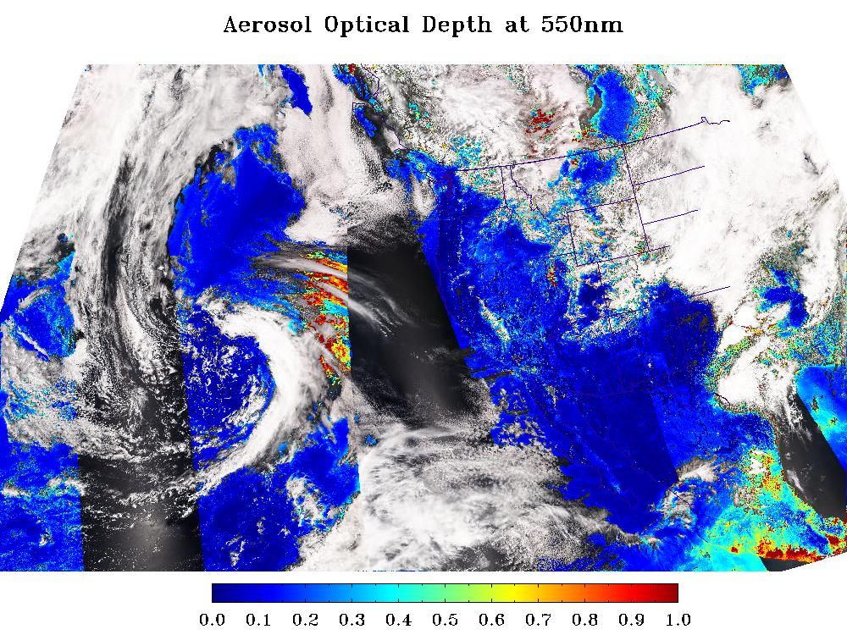
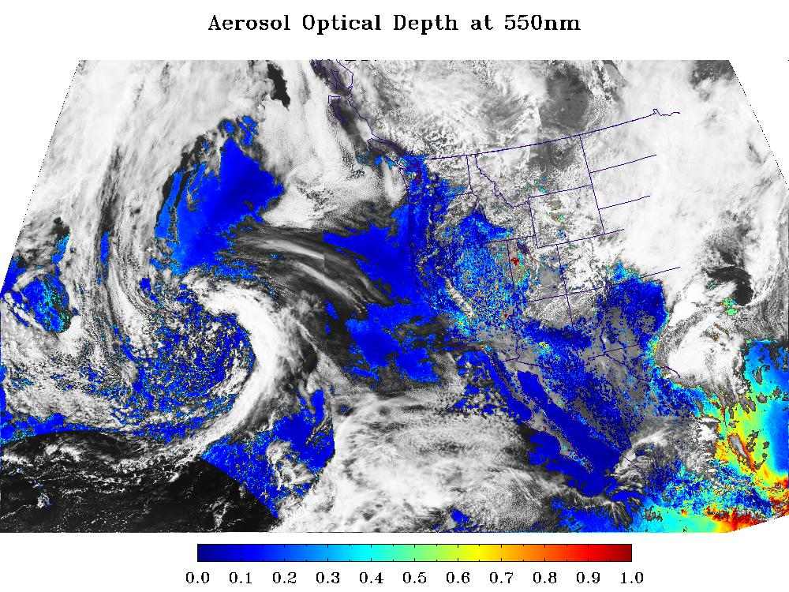
NOAA-20 vs. GOES-17
Medium+High QC AOD
NOAA-20/VIIRS
05/01/2019
GOES-17/ABI
23:00
21:20
19:40
23:00
21:20
19:40
Same findings as for S-NPP.

Slide 27
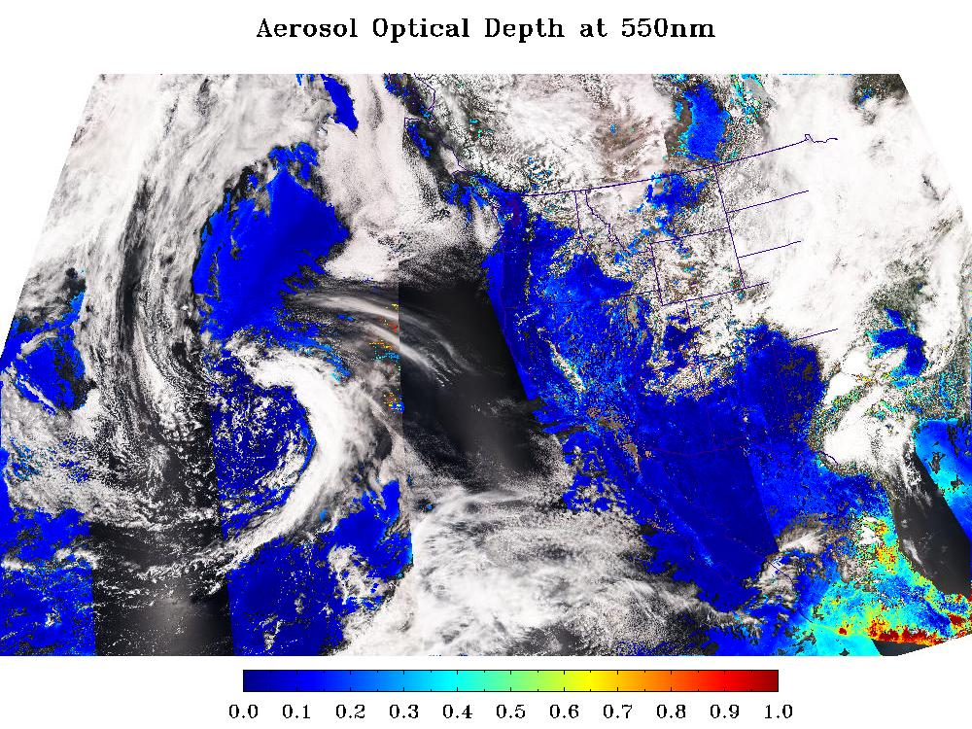

NOAA-20 vs. GOES-17
High QC AOD
NOAA-20/VIIRS
05/01/2019
GOES-17/ABI
23:00
21:20
19:40
23:00
21:20
19:40
Same findings as for S-NPP.

Slide 28
Quantitative Comparisons
GOES-17 Aerosol Optical Depth L2 Product Provisional PS-PVR

Slide 29
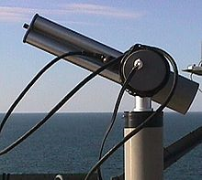
Reference Data
Reference data:
Version 3 L1.5 high-quality aerosol data from the ground-based Aerosol Robotic Network (AERONET) (Holben et al. 1998).
MODIS and VIIRS AOD.
GOES 16 AOD.
Time period:
01/01/2019 – 05/31/2019 (defined by availability of LWIR FPM temperature record.)
AERONET
Notes:
Time period: LWIR FPM temp record starts on 1/1/2019

Slide 30
Definitions of Metrics for Quantitative Comparisons
Passed: Accuracy and Precision meet or slightly exceed requirements. Potential contributors for deviations are identified.
Partial-Passed: Accuracy/Precision deviates significantly from requirements, but potential contributors for deviations are identified.
Failed: Accuracy/Precision deviates significantly from requirements and source of poor performance is unknown, or source known and correction requires new algorithm.

Slide 31
Comparison with AERONET ground measurements
GS AOD product over FULL DISK
GOES-17 Aerosol Optical Depth L2 Product Provisional PS-PVR

Slide 32
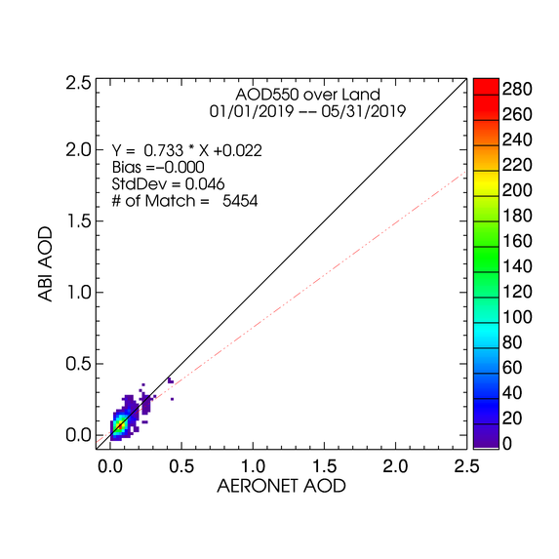
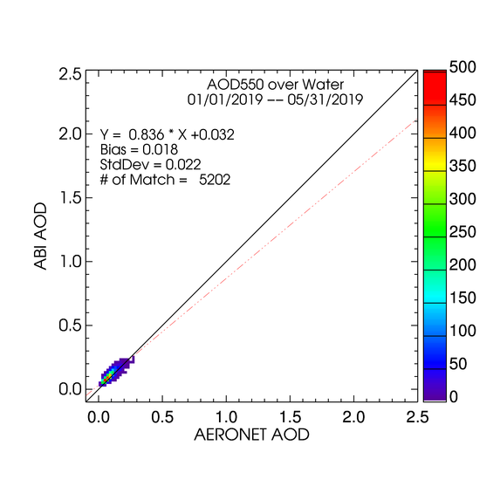
High QC GOES-17 AOD
LAND
WATER
High quality AODs are plotted regardless of magnitude (range).
Majority of points are around 1:1 line.
Very small negative bias over land and small positive bias over water.
STD over land is about twice as large as that over water.

Slide 33
G17 AOD Statistics - FD
High Quality 550-nm ABI AOD (01/01/2019 – 05/31/2019)
Range | Land |  |  |  | Water
 | AOD | Accuracy | Precision | # of points | AOD | Accuracy | Precision | # of points
Low | <0.04 | 0.02 (0.06) | 0.04 (0.13) | 743 | <0.4 | 0.02 (0.02) | 0.02 (0.15) | 5,202
Medium | 0.04 - 0.8 | 0.00 (0.04) | 0.05 (0.25) | 4,711
High | > 0.8 | -- | -- | 0 | >0.4 | -- | -- | 0
Accuracy and precision of ABI 550-nm AOD in comparison with AERONET AOD over land and water using collocated ABI-AERONET dataset. F&PS requirements are in parenthesis.
(--) means data are not available and/or statistic is not calculated.
A & P are evaluated using only high QC AOD in the required AOD ranges. Here “low”, “medium” and “high” refer to the magnitude of AOD not to its quality.
Requirements are met but data are not available in high AOD value range.

Slide 34
G16 AOD Statistics – FD for Comparison with G17 Stats
High Quality 550-nm ABI AOD (01/01/2019 – 05/31/2019)
Range | Land |  |  |  | Water
 | AOD | Accuracy | Precision | # of points | AOD | Accuracy | Precision | # of points
Low | <0.04 | 0.00 (0.06) | 0.05 (0.13) | 5,628 | <0.4 | 0.02 (0.02) | 0.03 (0.15) | 8,662
Medium | 0.04 - 0.8 | 0.01 (0.04) | 0.07 (0.25) | 30,722
High | > 0.8 | 0.03 (0.12) | 0.24 (0.35) | 27 | >0.4 | -0.06 (0.10) | -- | 2
Accuracy and precision of ABI 550-nm AOD in comparison with AERONET AOD over land and water using collocated ABI-AERONET dataset. F&PS requirements are in parenthesis.
(--) means data are not available and/or statistic is not calculated.
Requirements are met but data over water are too few in high AOD value range to calculate Precision.
Comparing G16 stats (this slide) to G17 stats (previous slide) indicates similar retrieval qualities.
  Only the time periods are same; significantly more stations, and thus matchups, are available for GOES-16.

Slide 35
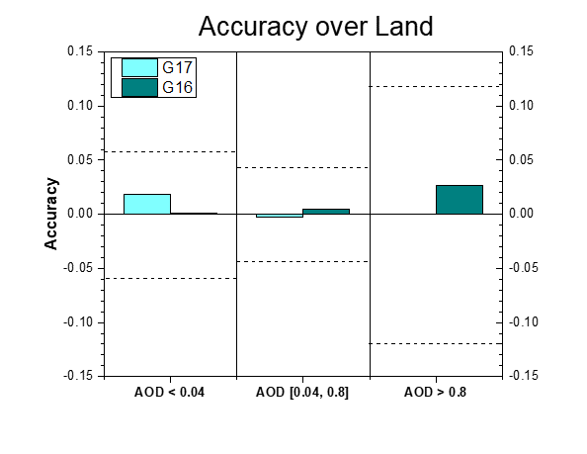
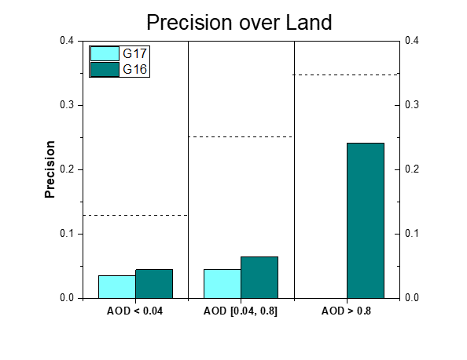
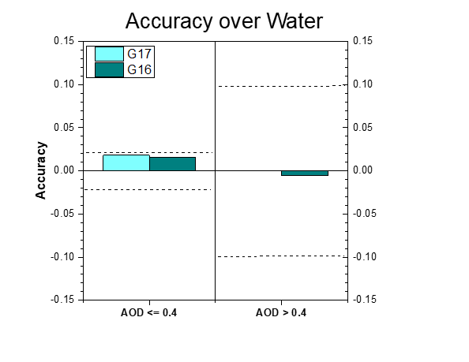
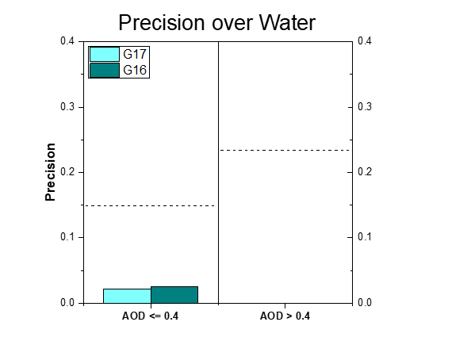
Graphical Summary of
G17 and G16 A and P
A and P (where exist) of G17 AOD are not very different from G16 A and P values in most AOD value ranges.

Slide 36
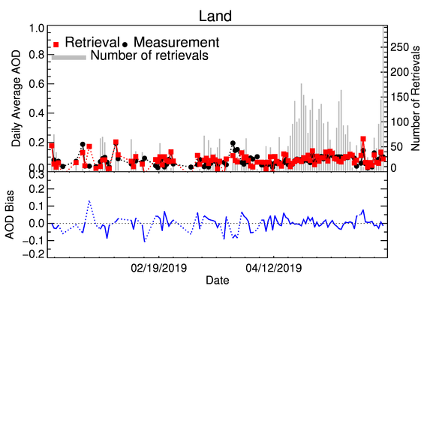
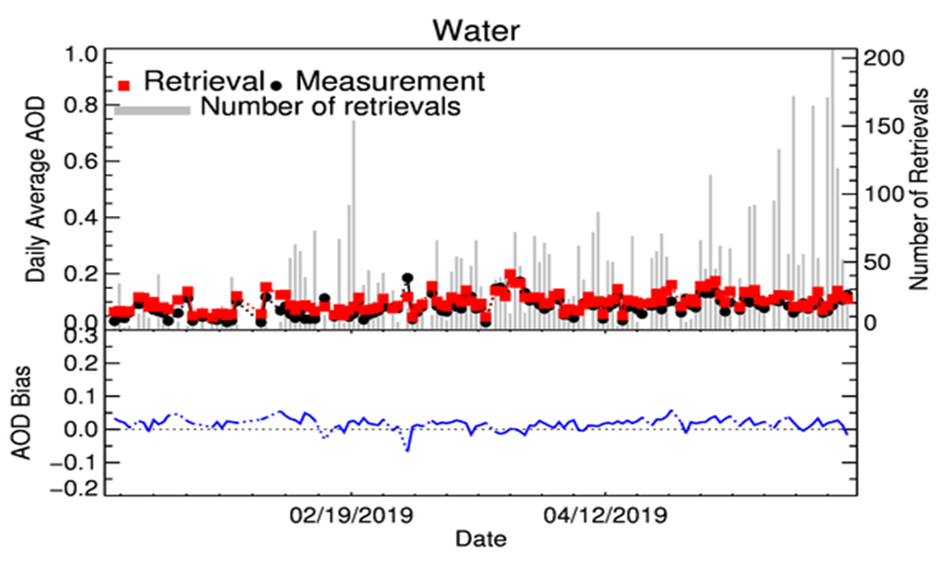
Time Series of G17 AOD
01/01/2019 – 05/31/2019 High QC
Time series of daily average operational high-quality GOES-17 and AERONET AOD and of GOES-17 minus AERONET difference (bias) for land (upper panel) and water (lower panel).
GOES-17 AOD tracks changes in AERONET AOD.
Day-to-day variability of bias is larger over land than over water.
No trend in bias.

Slide 37
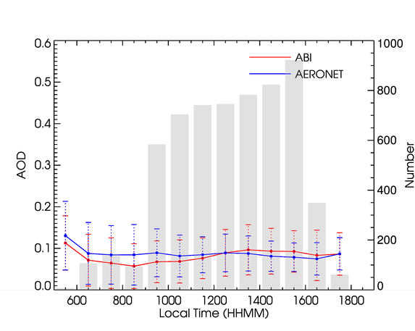
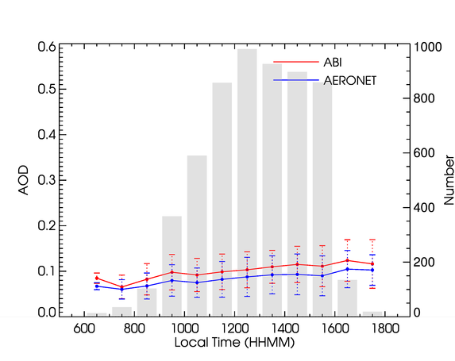
Diurnal Cycle - FD
01/01/2019 – 05/31/2019 High QC
Over Land
Over Water
AODs from all sites are averaged.
Daily variation of G17 AOD mostly follows that in AERONET AOD. (Not always true for individual sites!)
Over land, morning/afternoon G17 AODs are smaller/larger than AERONET AODs.
Over water, G17 AOD is larger than AERONET AOD all day long.

Slide 38
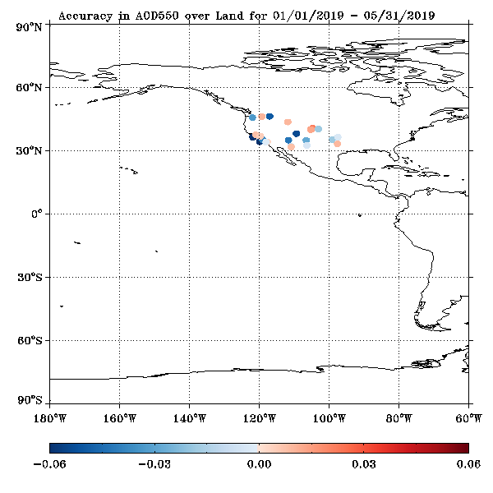
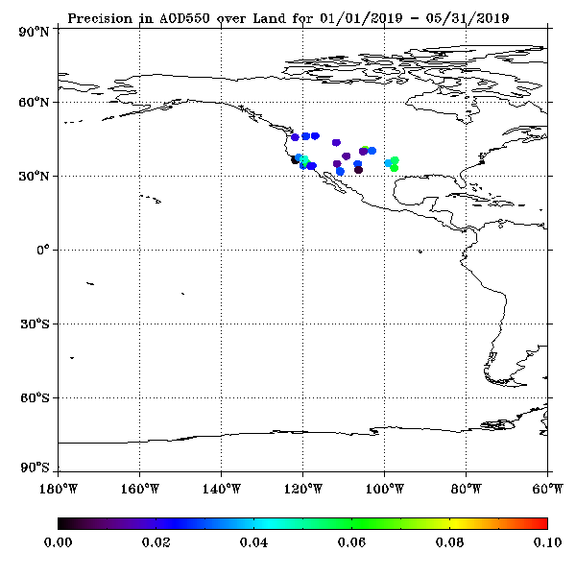
Accuracy and Precision at AERONET Sites - Land
01/01/2019 – 05/31/2019 High QC
Over land, magnitude and sign of bias varies from site to site.

Slide 39
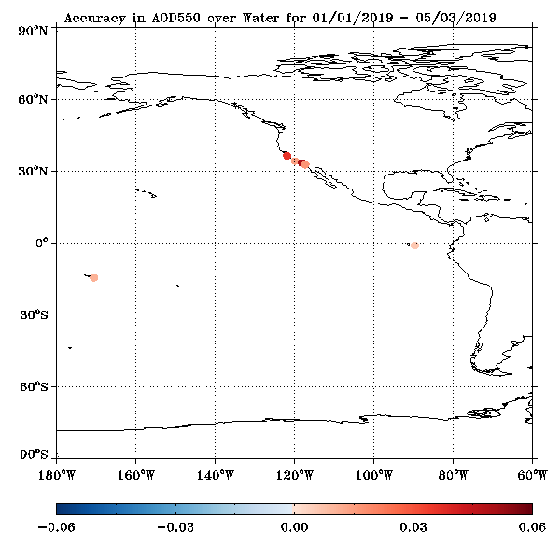
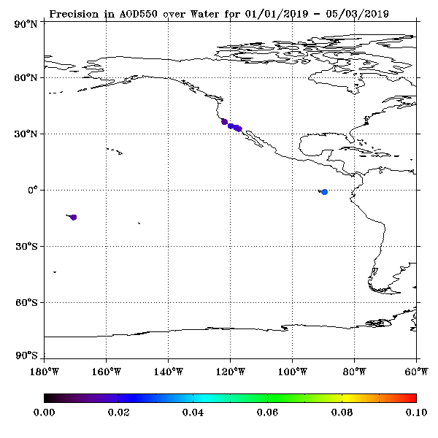
Accuracy and Precision at AERONET Sites - Water
01/01/2019 – 05/31/2019 High QC
Over water, bias is positive. (Sites are coastal or island sites!)

Slide 40
Comparison with AERONET ground measurements
GS AOD product over CONUS
GOES-17 Aerosol Optical Depth L2 Product Provisional PS-PVR

Slide 41
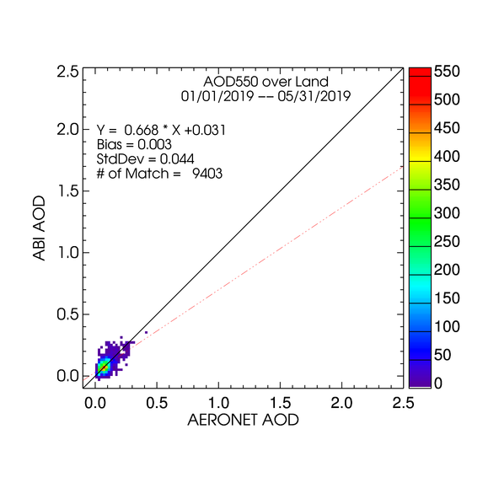
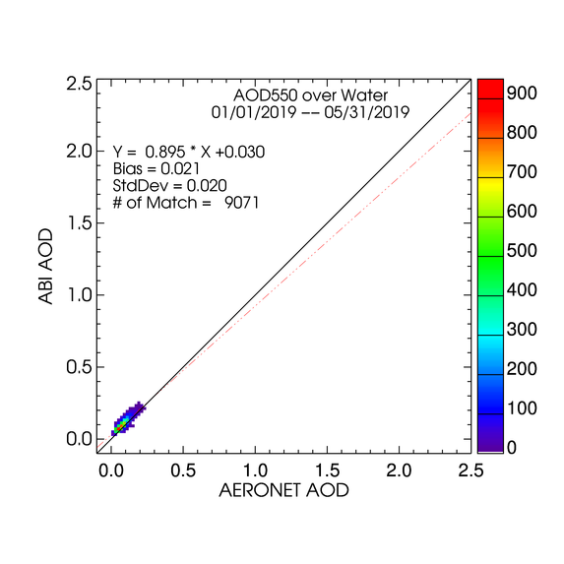
High QC - CONUS
LAND
WATER
High quality AODs are plotted regardless of magnitude (range).
Majority of points are around 1:1 line.
STD over land is about twice as large as that over water.
Very small positive bias over land and small positive bias over water.
41

Slide 42
G17 AOD Statistics - CONUS
High Quality 550-nm ABI AOD (01/01/2019 – 05/31/2019)
Range | Land |  |  |  | Water
 | AOD | Accuracy | Precision | # of points | AOD | Accuracy | Precision | # of points
Low | <0.04 | 0.02 (0.06) | 0.03 (0.13) | 1,433 | <0.4 | 0.02 (0.02) | 0.02 (0.15) | 9,071
Medium | 0.04 - 0.8 | 0.00 (0.04) | 0.05 (0.25) | 7,970
High | > 0.8 | -- | n/a (0.35) | 0 | >0.4 | -- | -- | 0
Accuracy and precision of ABI 550-nm AOD in comparison with AERONET AOD over land and water using collocated ABI-AERONET dataset. F&PS requirements are in parenthesis.
(--) means data are not available and/or statistic is not calculated.
A & P are evaluated using only high QC AOD in the required AOD ranges. Here “low”, “medium” and “high” refer to the magnitude of AOD not to its quality.
Requirements are met but data are not available in “high AOD” range.

Slide 43
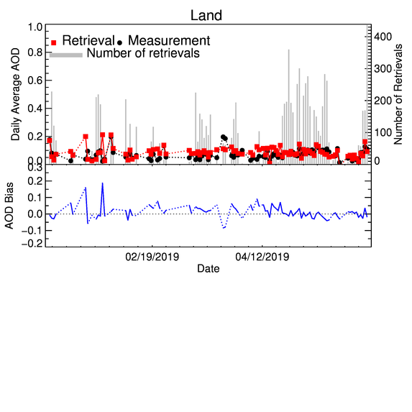
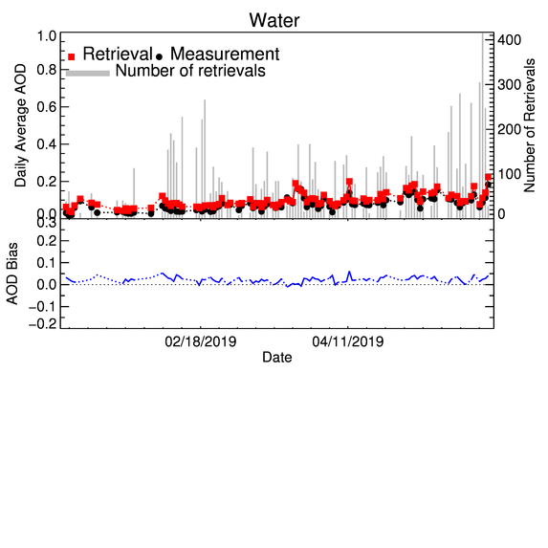
Time Series of G17 AOD - CONUS
01/01/2019 – 05/31/2019 High QC
Time series of daily average operational high-quality GOES-17 and AERONET AOD and of GOES-17 minus AERONET difference (bias) for land (upper panel) and water (lower panel).
GOES-17 AOD tracks changes in AERONET AOD.
Day-to-day variability of bias is larger over land than over water.
No trend in bias.

Slide 44
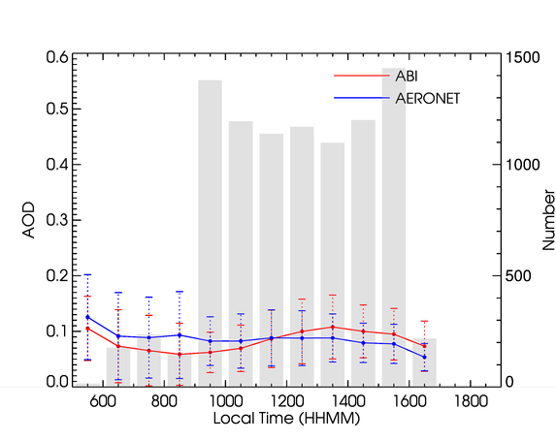
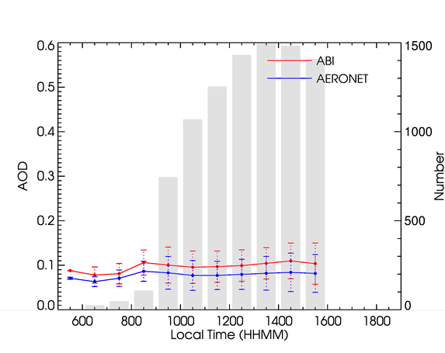
Diurnal Cycle - CONUS
01/01/2019 – 05/31/2019 High QC
Over Land
Over Water
AODs from all sites are averaged.
Daily variation of G17 AOD mostly follows that in AERONET AOD.
Over land, morning/afternoon G17 AODs are smaller/larger than AERONET AODs.
Over water, G17 AOD is larger than AERONET AOD all day long.

Slide 45

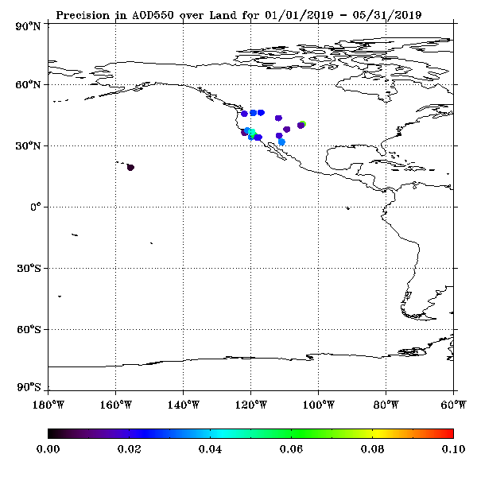
Accuracy and Precision at AERONET Sites - Land
01/01/2019 – 05/31/2019 High QC
Over land, magnitude and sign of bias varies from site to site.

Slide 46


Accuracy and Precision at AERONET Sites - Water
01/01/2019 – 05/31/2019 High QC
Over water, bias is positive. (Sites are coastal or island sites!)

Slide 47
Summary of GOES 17 vs. AERONET AOD Comparison
GOES-17 AOD retrievals were compared with AERONET version 3 level 1.5 data.
GOES-17 AOD meets the accuracy and precision requirements but data were not available in high AOD range. (Passed)

Slide 48
Comparison with VIIRS/MODIS/G16 at AERONET Stations
FULL DISK
GOES-17 Aerosol Optical Depth L2 Product Provisional PS-PVR

Slide 49
Comparison with VIIRS / MODIS
AOD over AERONET sites
Time period: 01/01/2019 – 05/31/2019.
Data:
  GOES-17: operational G17 GS AOD,
  VIIRS: S-NPP EPS AOD,
  MODIS: collection 6 Aqua and Terra AOD,
  GOES-16: operational G16 AOD.
A subset of matchups between the data above and AERONET is created:
  At each AERONET site, a matchup is considered when the ABI observation time in the AERONET-G17 matchup is within one-hour (10-min) window around the VIIRS/MODIS overpass (G16 observation) time in the AERONET-VIIRS/MODIS (G16) matchup.
M3, M4 and M6 ABI AODs with high quality are collected.

Slide 50
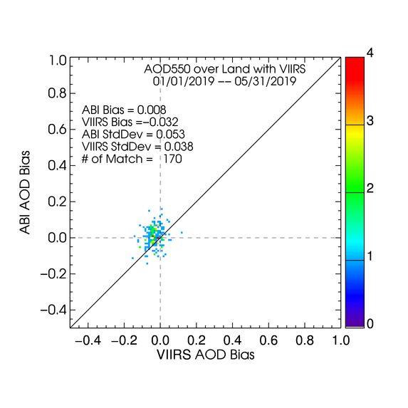
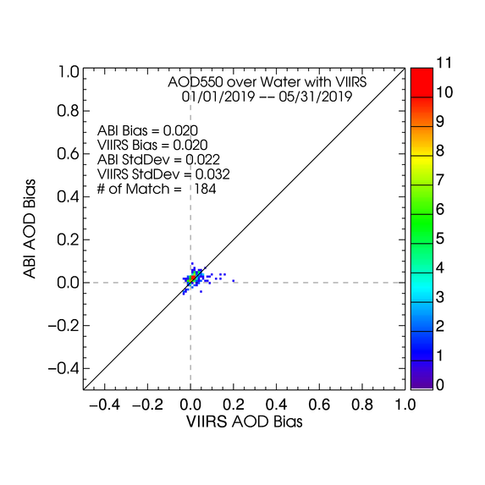
ABI bias vs. VIIRS bias
Over Land
Over Water
Distributions of G17/ABI and S-NPP/VIIRS biases (wrt AERONET) around the (0,0) point are not very different.

Slide 51
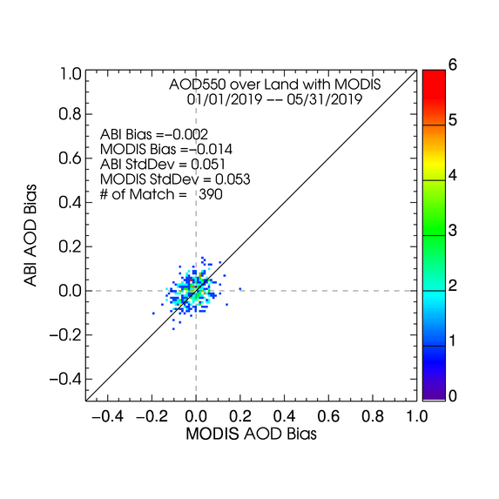
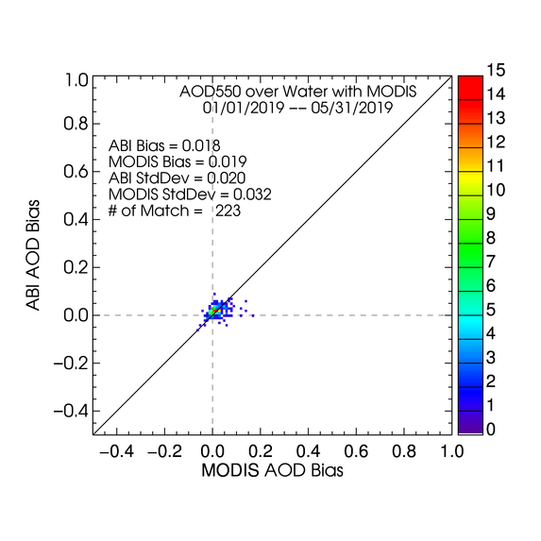
ABI bias vs. MODIS bias
Over Land
Over Water
Distributions of GOES-17/ABI and MODIS biases (wrt AERONET) are similar.

Slide 52
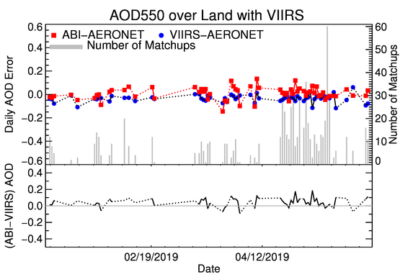

Time Series of Daily ABI and VIIRS Biases Relative to AERONET
Upper panel: Time series of G17/ABI minus AERONET and S-NPP/VIIRS minus AERONET biases for land (left) and water (right).
Lower panel: Time series of G17/ABI minus S-NPP/VIIRS differences for land (left) and water (right).
Day-to-day variability of differences is larger over land than over water.
No trend in bias.

Slide 53


Time Series of Daily ABI and MODIS Biases Relative to AERONET
Same as previous slide but for MODIS.
Magnitude of day-to-day variation of ABI and MODIS daily AOD biases are similar. Sometimes MODIS does “better”, at other times ABI bias is smaller.
Agreement between ABI and MODIS appears to be better than for VIIRS, likely because morning and afternoon MODIS leads to more observations, and thus to matchups.

Slide 54


GOES-17 vs. GOES-16 bias
Ranges of GOES-17 and GOES-16 biases are similar.
Note that the current land surface relationship is mostly from data over the test positions and not optimal for either GOES-16 or GOES-17.

Slide 55


Time Series of Daily GOES-17 and GOES-16 Biases Relative to AERONET
Magnitude of day-to-day variation of G17 and G16 daily AOD biases are similar.

Slide 56
Comparison with VIIRS/MODIS/GOES-16 at AERONET Stations
CONUS
GOES-17 Aerosol Optical Depth L2 Product Provisional PS-PVR

Slide 57


ABI bias vs. VIIRS bias - CONUS

Slide 58


ABI bias vs. MODIS bias - CONUS

Slide 59


Time Series of Daily ABI and VIIRS Biases Relative to AERONET
CONUS

Slide 60


Time Series of Daily ABI and MODIS Biases Relative to AERONET
CONUS

Slide 61


GOES-17 vs. GOES16 bias - CONUS

Slide 62


Time Series of Daily GOES-17 and GOES-16 Biases Relative to AERONET - CONUS
Magnitude of day-to-day variation of G17 and G16 daily AOD biases are similar.

Slide 63
Summary of Comparison with MODIS, VIIRS, and GOES-16
GOES-17 AOD retrievals have been compared with VIIRS, MODIS and GOES-16 AOD retrievals at AERONET sites.
Over water, GOES-17, VIIRS, MODIS and GOES-16 are statistically similar; GOES-17 standard deviation is somewhat smaller than VIIRS and MODIS standard deviations. (Passed)
Over land, GOES-17 and MODIS statistics are comparable, but GOES-17 standard deviation is somewhat higher than VIIRS, likely because the current land surface relationship is not optimal for GOES 17. (Passed)

Slide 64
Provisional Maturity Assessment
GOES-17 Aerosol Optical Depth L2 Product Provisional PS-PVR

Slide 65
Provisional Validation
Preparation Activities | Assessment
Validation activities are ongoing and the general research community is now encouraged to participate. | Validation activities are ongoing. The general research community has been participating and providing feedback.
Risks to provisional are identified and the impact are minor. Solutions to risks are in development. | Operational and algorithm risks have been identified. Five AOD ADRs remain open (zonal percentages, TPW value/flag, occasional missing block); none impacts accuracy or precision.
Incremental product improvements may still be occurring. | Incremental product improvements are expected.

Slide 66
Provisional Validation
End State | Assessment
Product performance has been demonstrated through analysis of a small number of independent measurements obtained from select locations, periods, and associated ground truth or field campaign efforts. | This has been demonstrated using AERONET as ground truth and independent statellite retrivals from VIIRS/MODIS and GOES16.
Product analysis is sufficient to communicate product performance to users relative to expectations (Performance Baseline). | This has been communicated in PS-PVR.
Documentation of product performance exists that includes recommended remediation strategies for all risks and weaknesses. Any algorithm changes associated with risks have been documented, implemented, tested, and shared with the user community. | These are documented in this PS-PVR presentation and will be documented in a separate ReadMe file.
Product is ready for operational use and for use in comprehensive cal/val activities and product optimization. | We concur.

Slide 67
Plans for Assessment of warm period

Slide 68
Impact of GOES-17 LHP anomaly on AOD Products
Direct impact: NO.
  ABI VIS & NIR channels (Bands 1 – 6) are used primarily as inputs in AOD retrieval – These bands are not impacted by LWIR temperature anomaly. Only Band 14 (11.2 m) is impacted.
Indirect impact: YES, but likely minimal.
  AOD algorithm uses upstream Clear-sky Mask that is impacted by LWIR focal plane module (FPM) temperature anomaly.
  AOD products are daytime products; impact of excessive LWIR FPM temperatures are somewhat minimized by times daylight and solar zenith angle limit for high-quality AOD.
Main impact is through ABI Clear-Sky Mask.
PCAL extends the time period of usable AOD retrievals by about an hour.
Material supporting the statements above is in the Supplement. (Impact of LWIR FPM Anomaly)

Slide 69
Plan for Assessing Warm Period and Mitigation
Plan:
  Use GOES-17 AOD from warm period with predictive calibration (PCAL) turned on.
  Compare with corresponding GOES-16 AOD for GOES-17/GOES-16 overlap area, and with AERONET (needs long record!)
  Evaluate high LWIR FPM temperature flag in ABI L1B data if its use in AOD algorithm further helps avoiding times of high FPM temperatures.
Mitigation:
  No changes in AOD algorithm are planned (none of the bands used but one is impacted).
  But, if needed, implement screening pixels for high LWIR FPM temperature based on flag in ABI L1B and set quality to low or discard retrieval. It is unlikely that this will be needed since Clear-sky Mask should already account for the impact.

Slide 70
Path to full Validation Maturity
GOES-17 Aerosol Optical Depth L2 Product Provisional PS-PVR

Slide 71
Issues and Status
ADRs Potentially Needing Resolution for Full VAL
ADR | Title | Status | Build
920 | Incorrect zonal percentage metadata | In analysis | --
801, 899 | Incorrect TPW Input and/or flag | In analysis | --
818, 947 | Occasional missing blocks over full disk AOD (CONUS) product | In analysis | --
None of these affects accuracy and precision, except maybe ADR899 to some degree, and so …
for achieving Full Validated Maturity they may not be critical.
However, fixing them is highly desirable; especially ADR 920 which may be used (by OSPO) in product monitoring.

Slide 72
Issues and Status
Other Actions Needed for Full VAL
Action | Title | Desired Implementation Date into OE
New ADR(s) needed | L2 AOD algorithm - update the LUT, spectral coefficients, and land surface relationship derived from GOES-17 data at the operational position and from corrected Band 2 reflectance | ≧6 month prior to PS-PVR FULL
New ADR(s) needed | L2 AOD algorithm – add a buffer to the processing block to improve the standard deviation test. | ≧6 month prior to PS-PVR FULL
New ADR(s) needed | L2 AOD algorithm – Add and/or alter internal tests | ≧6 month prior to PS-PVR FULL
Matchups used to derive current land-surface reflectance relationships are collected for the period 4/29/2017 and 1/15/2018 between G16 L1b reflectances and AERONET AOD.
  Late winter and early spring is not represented.
G17 evaluation used winter-spring (2019) data! This contributes to G17 AOD errors.

Slide 73
Path to Full Validation - PLPTs
PLPT ID | Descriptive Title
ABI-FD_AOD09 | Assess precision and accuracy of FD product for a wide range of representative conditions (i.e., seasonal) over a period of at least a year.
ABI-CONUS_AOD10 | Assess precision and accuracy of CONUS product for a wide range of representative conditions (i.e., seasonal) over a period of at least a year.
AWG AOD Team will conduct these tests to further evaluate the L2 AOD product quality.
Full test plans and procedures are given in the AOD Readiness, Implementation, and Management Plan (RIMP v1.0; 416-R-RIMP-0326)

Slide 74
Path to Full Validation – Risks
Risk Name | Description | Impact |  | Mitigation and Schedule
Update LUT, coefficient and land surface relationships | as discussed; Priority 1 | Moderate |  | New WR/ADR needed
Update AOD algorithm QC thresholds | as discussed; Priority 2 | Moderate |  | New WR/ADR needed
Add a buffer to processing block | as discussed; Priority 3 | Moderate | Little | New WR/ADR needed
Little Impact
Moderate Impact
Big Impact

Slide 75
Summary & Recommendations
GOES-16 Aerosol Optical Depth L2 Product Provisional PS-PVR

Slide 76
Summary
Overall, the AOD product is ready for operational and scientific use
  AOD product is useable excluding times of FPM anomaly.
  In general, high quality retrievals are recommended for quantitative applications due to their better overall performance; however, the lower quality retrievals also have their merit for qualitative examination of local episodic events due to their greater spatial coverage.
Measured AOD performance against reference data
  Accuracy specs are met, but data were not available in high AOD range.
  Precision specs are met, but data were not available in high AOD range.
  Updates will be needed for LUT, spectral coefficients, land surface relationship and internal test thresholds to further improve performance.

Slide 77
Recommendation
AWG Aerosol Team believes that the GOES-17 L2 AOD product has reached Provisional Maturity for the cool period as defined by the GOES-R Program.

Slide 78
SUPPLEMENT

Slide 79
Upstream Algorithm Issue
Impact of LWIR FPM Anomaly
GOES-17 Aerosol Optical Depth L2 Product Provisional PS-PVR

Slide 80
Evaluation Strategy
Test the impact of ABI FPM temperature on GOES-17 AOD product during the time of rapid FPM temperature change for 1300 – 1600 UTC on 02/26/2019.
Run the AOD algorithm offline using M6 GOES-17 data with predictive calibration applied and the latest cloud mask product (based on the predictive calibration).
  Case “GOES17”: offline run using operational radiance and clear sky mask.
  Case “GOES17PC”: offline run using both radiance (BT14) and cloud mask with predicted calibration.
  Case “GOES16”: offline run using G16 operational radiance and clear sky mask for comparison.

Slide 81


Overlap Area

Slide 82


Selected Overlap Area

Slide 83


Number of Retrievals vs. Time of Day
Left: low+medium+high quality; Right: only high quality.
Number of G17PC (PCAL) AOD retrievals is larger than that from G17 (without PCAL).
No high-quality retrievals from G17 until about 16 UTC.
PCAL significantly increases the number of retrievals; brings it closer to that from G16.
Notes:
GS vs. local baseline with “internal tests”

Slide 84






AOD vs Time of Day
Top: low+medium+high (all) quality; Bottom: only high quality.
Over water, PCAL decreases GOES-17 minus GOES-16 all-quality AOD difference (GOES17PC-GOES16). For high quality AOD PCAL does not make much difference.
Over land, there is no significant difference between using non-PCAL and PCAL reflectances, except maybe early hours when GOES17PC deviates more from GOES16. Likely view-angle related errors in AOD complicate reaching a conclusion.
Notes:
GS vs. local baseline with “internal tests”

Slide 85
Impact of LWIR FPM Anomaly Summary
Over land, the comparison of GOES-17 and GOES-16 AOD retrievals is inconclusive, most likely due to view-angle induced differences in AOD for pixels where retrievals are attempted.
Over ocean, the GOES-17 AOD with the predictive calibration compares better with GOES-16 AOD, and extends the time period of usable AOD retrievals by about an hour.
BACK

Slide 86
Upstream Algorithm Issue
Impact of ABI Band 2 gain change
GOES-17 Aerosol Optical Depth L2 Product Provisional PS-PVR

Slide 87
Evaluation Strategy
ADR 792: GOES-17 ABI B02 (640 nm) bias
Data used:
  AOD from DE and OE for 12/2/2018,
  AERONET AOD as reference.
Evaluation:
  DE-OE differences at a selected time.
  High-quality DE AOD vs. OE AOD at every 15 minutes.
  Comparison with reference data.
  Comparison of diurnal cycle.

Slide 88


DE-OE FD Differences at 23:30 UTC (worst case)
Low+Medium+High Quality AOD
High Quality AOD
CAVEAT:
Some DE-OE differences are due to differences in input and in ancillary data!
Mean DE-OE differences are small; -0.004 for LMH quality and 0.002 for H quality.
At a few pixels differences can be as large as ~4 for LMH or ~2 for H.
88

Slide 89


DE vs. OE High-Quality FD AOD (Animation)
Mean DE-OE differences over land are small, except at few time steps.
89

Slide 90


Comparison of High-Quality AOD with AERONET over Land
OE
DE
Over land, ADR 792 reduces the bias. StdDev is slightly increased.
90

Slide 91
Accuracy & Precision of OE and DE AOD Data
OE High Quality 550-nm ABI AOD
Range | Land |  |  |  | Water
 | AOD | Accuracy | Precision | # of points | AOD | Accuracy | Precision | # of points
Low | <0.04 | -0.02 | 0.02 | 56 | <0.4 | 0.04 | - | 2
Medium | 0.04 - 0.8 | -0.05 | 0.02 | 11
High | > 0.8 | - | - | - | >0.4 | - | - | N/A
DE High Quality 550-nm ABI AOD
Range | Land |  |  |  | Water
 | AOD | Accuracy | Precision | # of points | AOD | Accuracy | Precision | # of points
Low | <0.04 | 0.00 | 0.02 | 57 | <0.4 | 0.03 | - | 2
Medium | 0.04 - 0.8 | -0.03 | 0.02 | 12
High | > 0.8 | - | - | - | >0.4 | - | - | -
91
The dash (-) means either there is no AOD or the number of retrievals is too small to calculate the statistic.

Slide 92




Diurnal Cycle
 | OE | DE
FD
CONUS
Difference between the diurnal variability of ensemble ABI and AERONET is somewhat reduced as a result of ADR 792.
Diurnal cycle difference can be larger/smaller at individual AERONET sites (not examined).
92

Slide 93
Impact of G17 ABI Band 2 Bias Summary
ADR 792 (G17 ABI B02 bias) overall does not negatively impact the AOD product.
Some differences between the DE and OE products are clearly visible but generally minor, especially for high quality AOD.
The change in B02 resulted in a small increase of the mean AOD over land and a small decrease over water.
Comparisons with reference data from AERONET suggests that ADR 792 somewhat reduces the bias, increases sample size, and improves diurnal variation of AOD.
CAVEATS:
  Inputs may also be different in the OE and DE; these differences likely contribute to the total difference and thus make attribution somewhat less straightforward.
  Processing coefficients are based on uncorrected B02!
  Having data only for a single day is not sufficient to establish a robust statistics to characterize product quality.

Slide 94
Brief overview of the AOD algorithm

Slide 95

Algorithm Overview
Channels used for aerosol retrieval
The AOD algorithm :
Compares selected VIS and NIR ABI reflectances with reflectances calculated for a discrete set of AOD and aerosol models.
Selects AOD and aerosol model for which calculated reflectances best match observed ones.
ABI Band | Central Wavelength (µm) | Retrieval |  | Internal Test
 |  | Land | Water | Land | Water
1 | 0.470 | X |  | X | X
2 | 0.640 | X | X | X | X
3 | 0.865 |  | X | X | X
4 | 1.378 |  |  | X | X
5 | 1.610 |  | X | X | X
6 | 2.250 | X | X | X | X
14 | 11.200 |  |  | X | X
aerosol model 1
aerosol model 2
Separate algorithms for water and land
  Water: surface reflectance calculated from model
  Land: VIS surface reflectance estimated from ABI band 6 via preset relationships
Aerosol models:
  Water: 4 fine and 5 coarse modes
  Land: dust, smoke, urban and generic
Residual 1
Observation
TOA reflectance in band B
Residual 2
Retrieved AOD
(and model)
TOA reflectance in band A

Slide 96
Internal Tests
Condition | Quality Level |  |  | Applies to |  | Detected by
 | No Retrieval | Low | Medium | Land | Ocean | External Mask | Internal Tests
Invalid input data | X |  |  | X | X |  | X
Cloud | X |  |  | X | X | X | X
Snow/Ice | X |  |  | X | X | X | X
Ephemeral Water | X |  |  | X |  |  | X
Sun Glint | X |  |  |  | X |  | X
Bright Land Surface | X |  |  | X |  |  | X
AOD Out of Range |  | X |  | X | X |  | X
Low Sun (solzen > 80°) |  | X |  | X | X |  | X
Low Satellite (satzen > 60°) |  | X |  | X | X |  | X
E & I cloud tests contradict |  | X |  | X | X | X | X
Coastal |  | X |  | X | X | X
Shallow Inland Water |  | X |  |  | X | X | X
High Inhomogeneity |  | X |  | X | X |  | X
High Residual |  | X |  | X | X |  | X
Cloud/Snow Adjacency |  |  | X | X | X |  | X
Shallow Ocean |  |  | X |  | X | X | X
Probably Clear |  |  | X | X | X | X
Medium Inhomogeneity |  |  | X | X | X |  | X
Medium Residual |  |  | X | X | X |  | X

